Slide 1


A celebration and a history

Slide 2
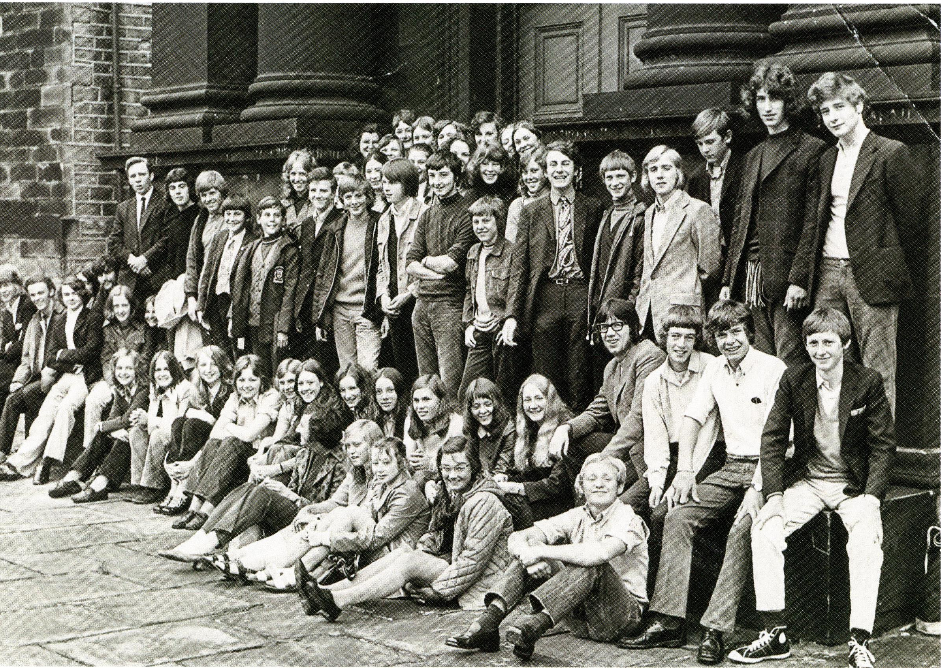
Huddersfield Wind Band originated from the Huddersfield Youth Orchestras, which were part of the music education scene in the town from the 1960s.
Many members of HWB started off in Huddersfield Youth Orchestras which were conducted by Adrian Baxter.
And yes!!! That is Adrian on the left at the back.
There is another copy of this on display with names attached – see if you can recognise yourself.

Slide 3
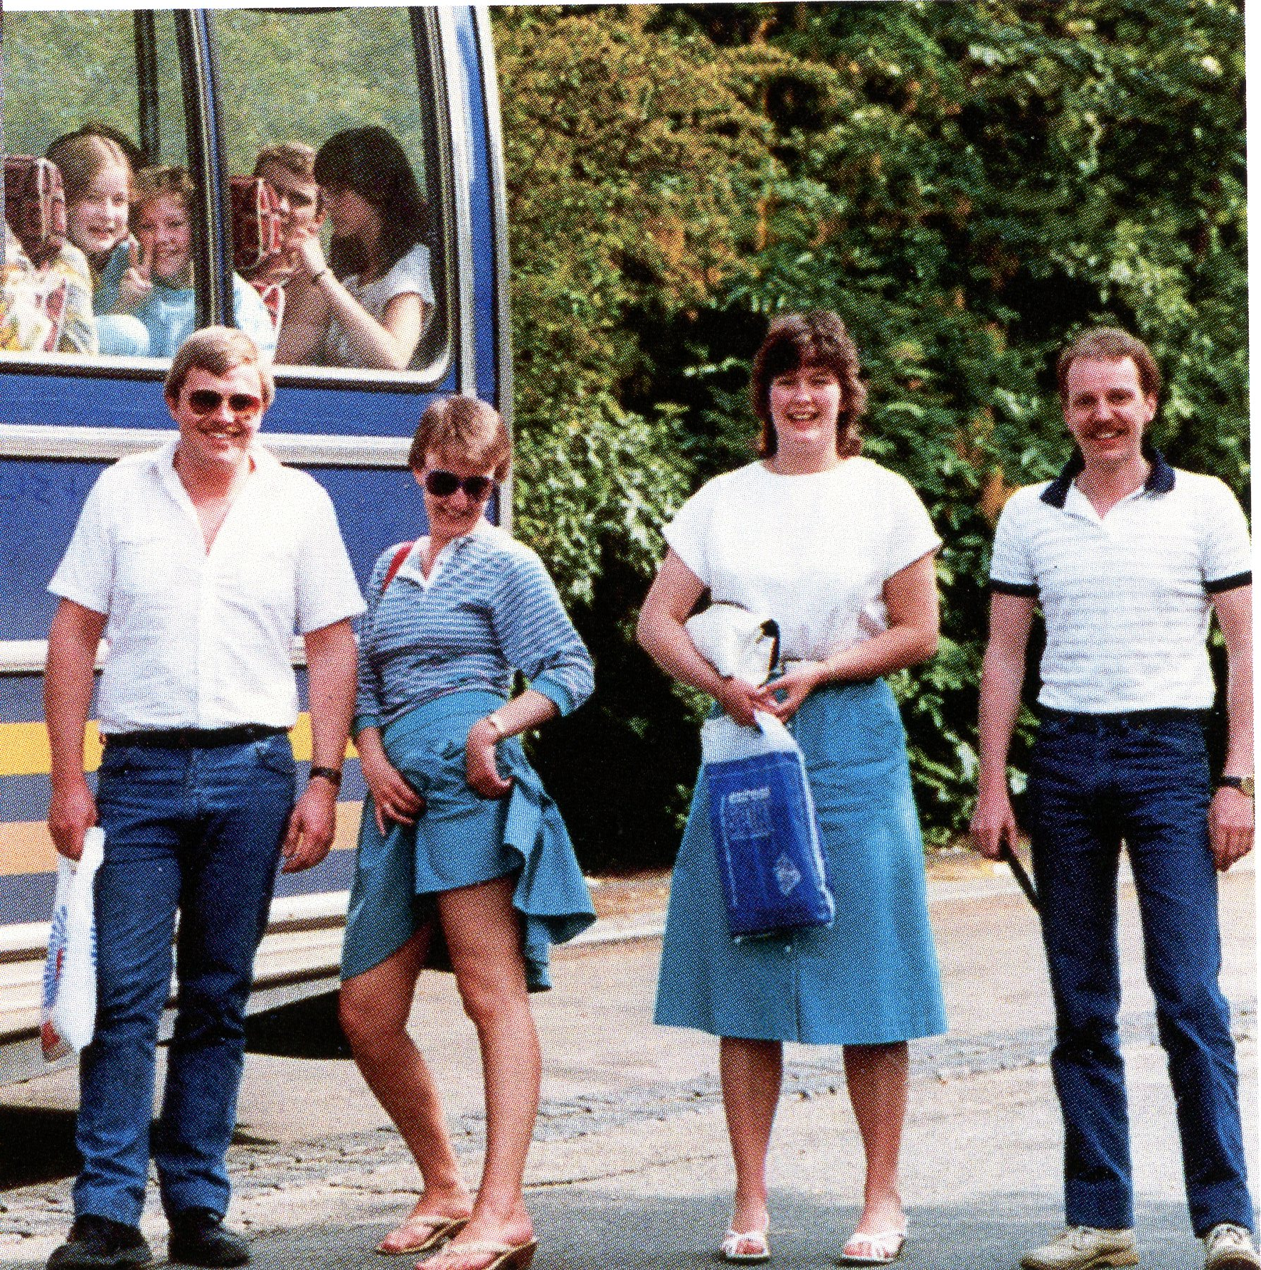
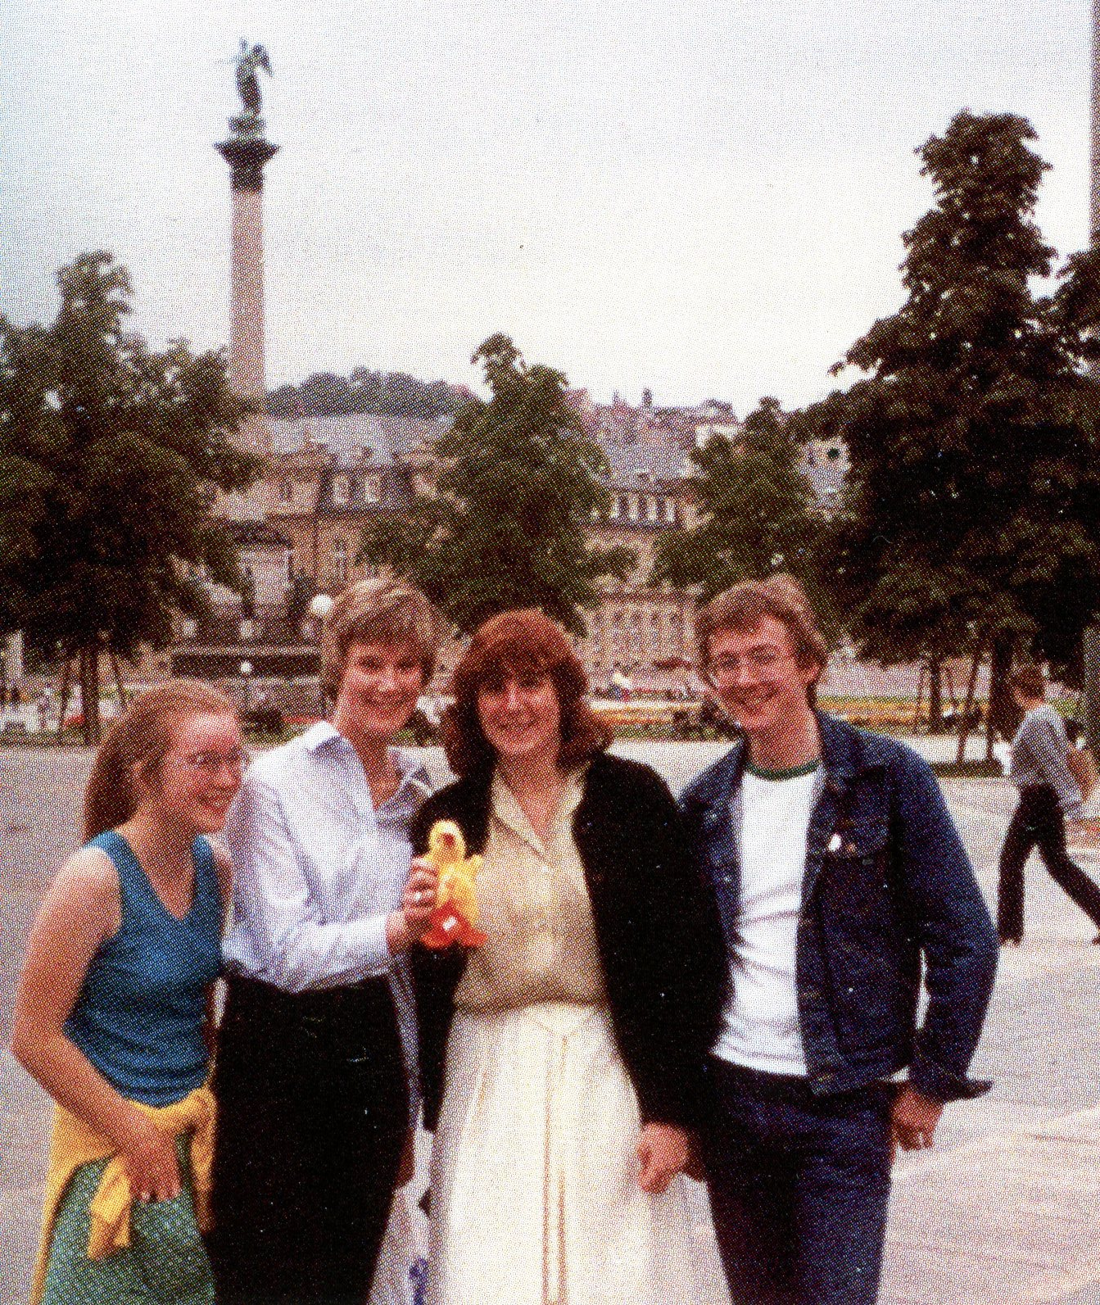
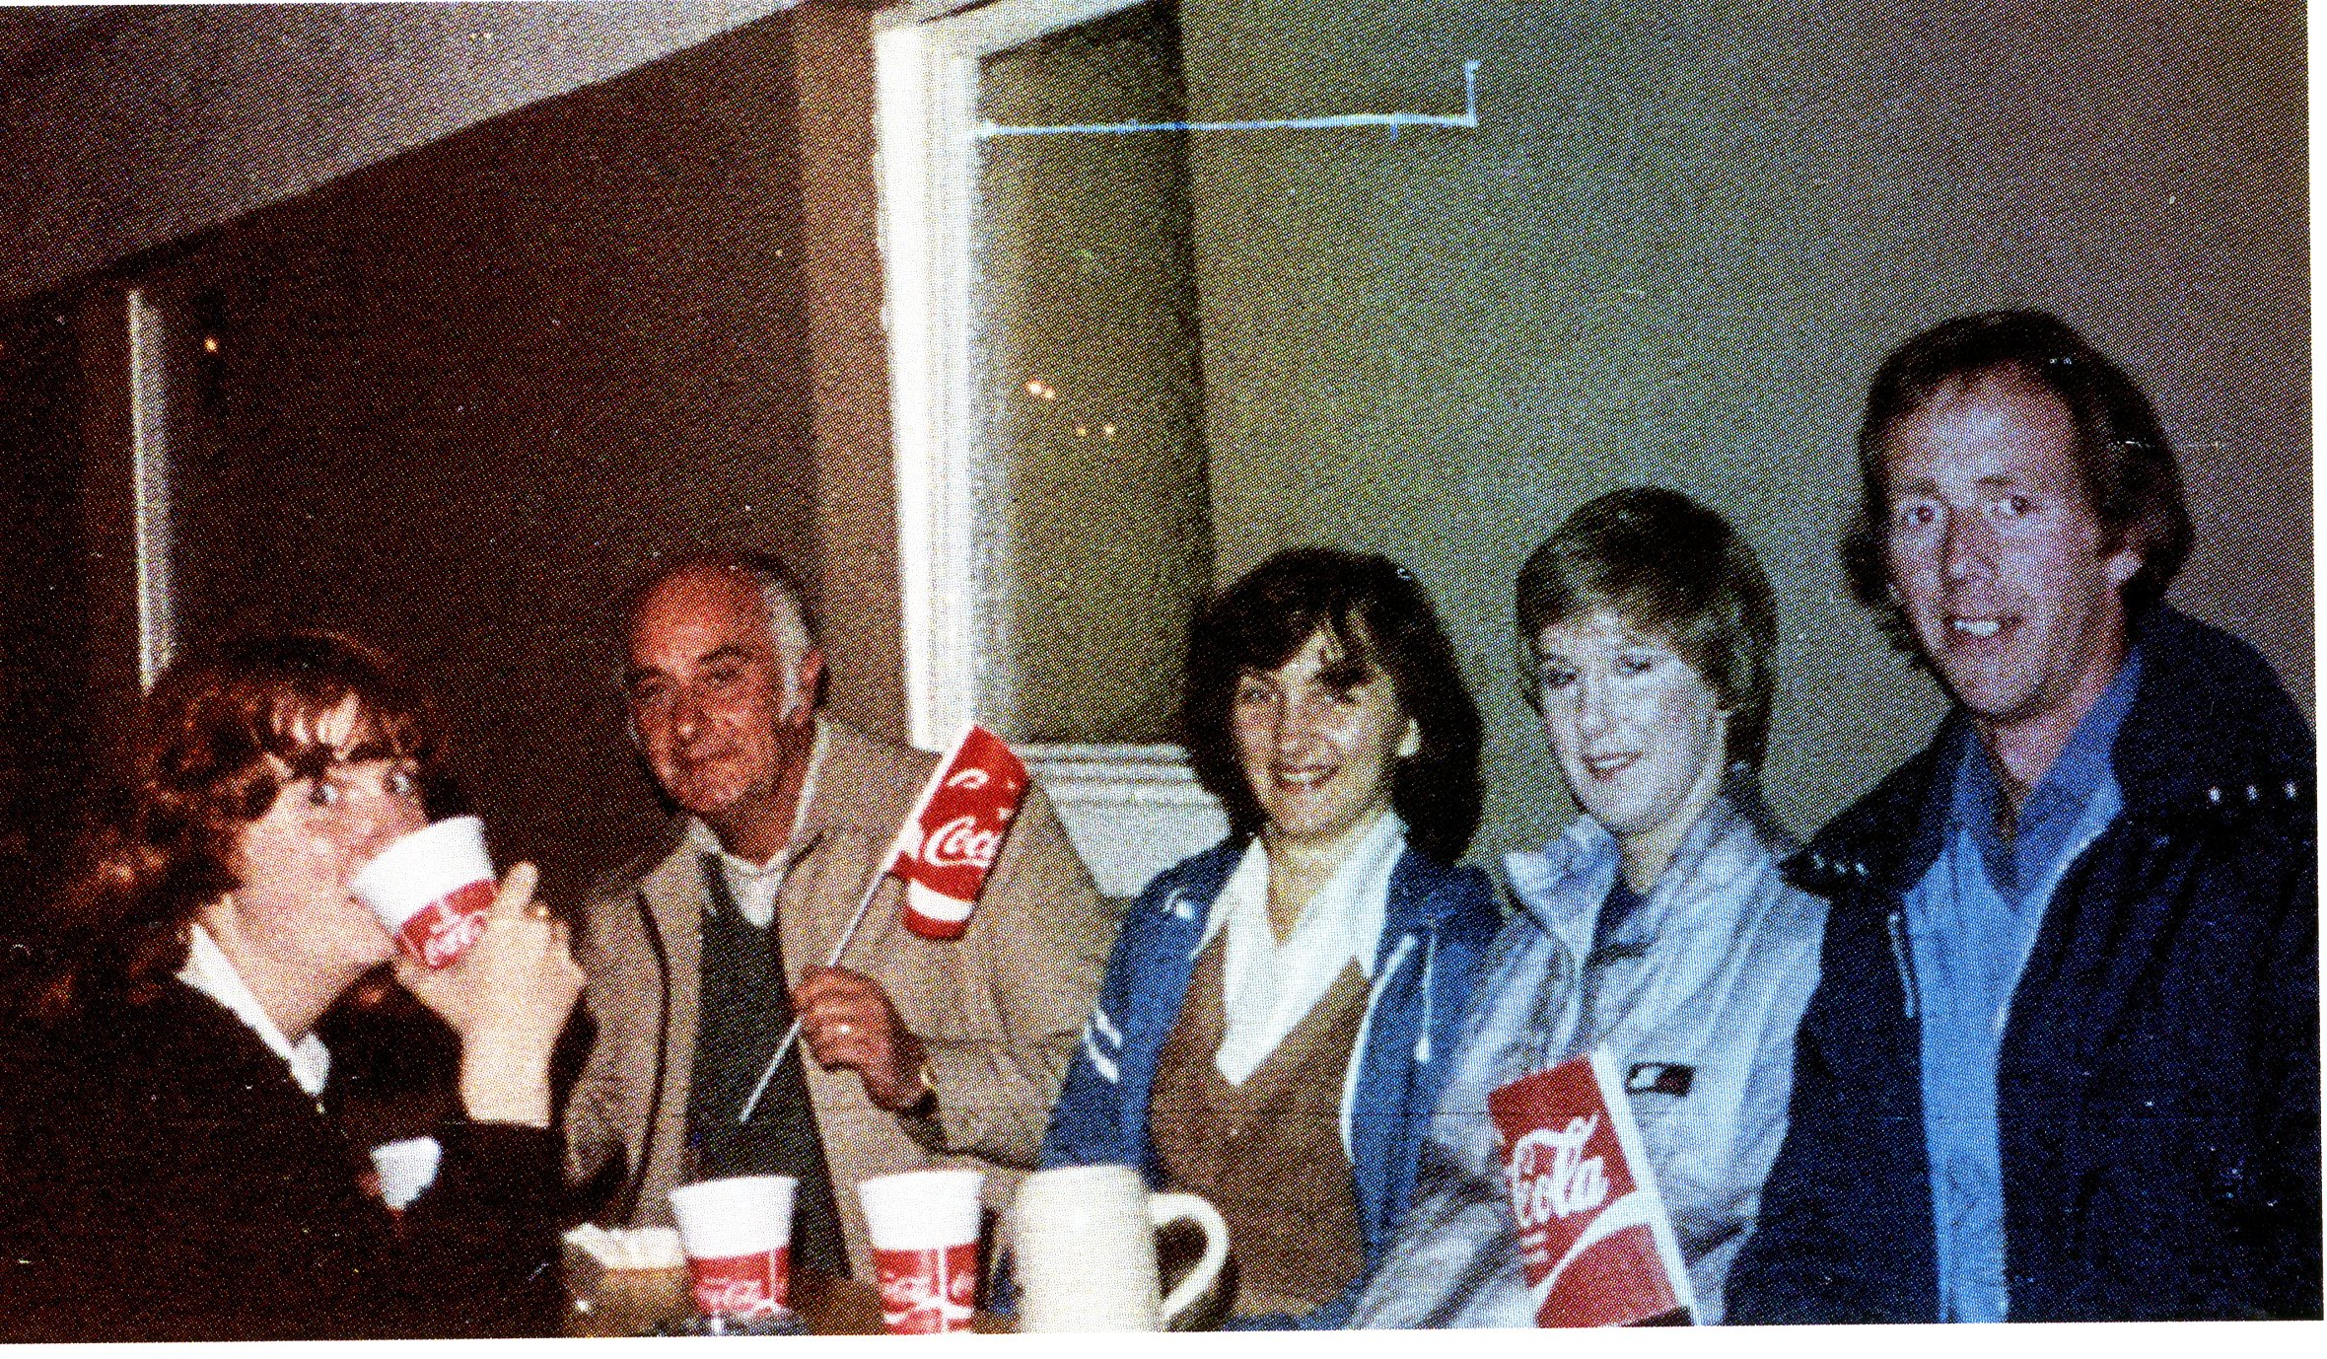
Some members never left and are still play with us today.
You might just be able to spot them in the band tonight!
Along the way we have lost some friends, however, new members have come and joined the band over the years.

Slide 4
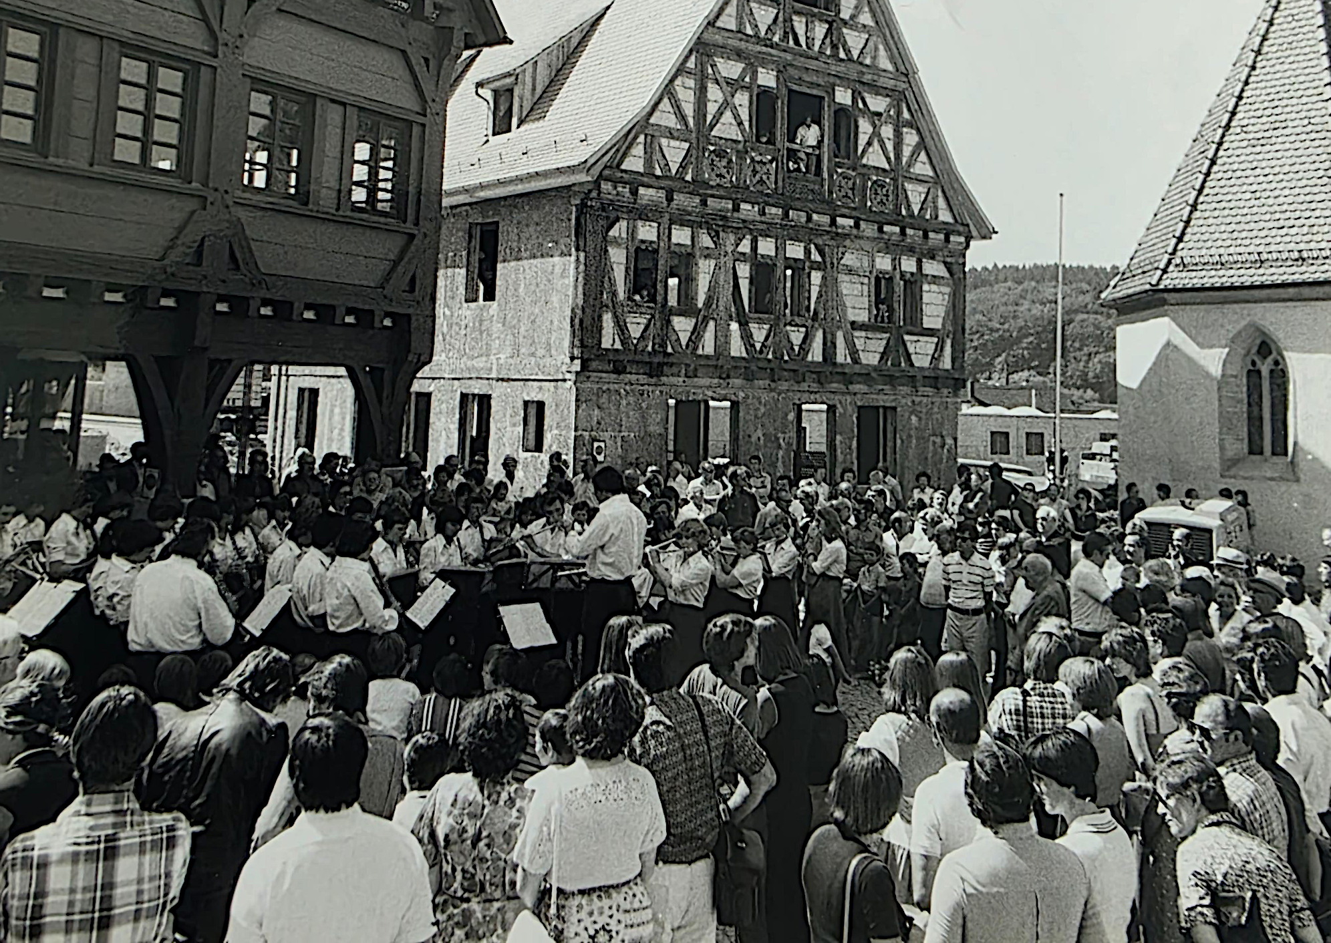
In the early years, the band visited Germany and built friendships with the MusikVerein in Altbach. Those friendships remain to this day.
Again, some of the people in this photo are still with us tonight.

Slide 5
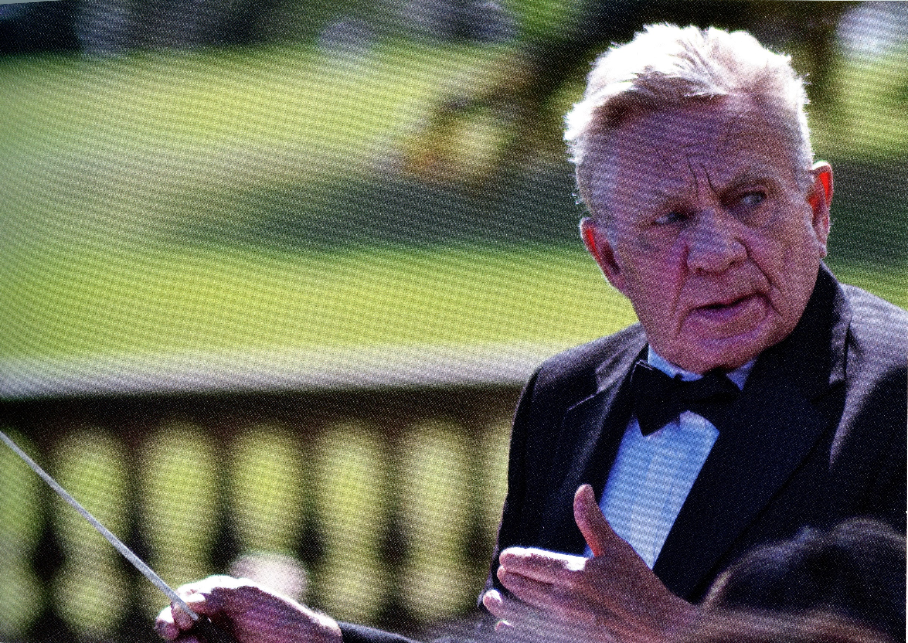
Following a restructure of the Kirklees Music establishment in 1986, Adrian decided to strike out on his own and formed Huddersfield Wind Band. Naturally enough many of us followed him to create the new band.

Slide 6
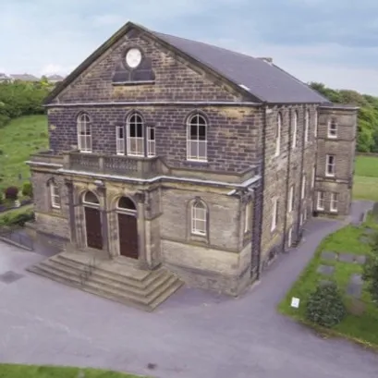
For a few years, the band rehearsed at different locations in Kirkheaton. This included the old infants school opposite the parish church (and conveniently near the Beaumont Arms); before moving to our current home here at Salendine Nook Baptist church.
This gave the band a much larger rehearsal space for the growing membership and a fantastically ready-made concert venue.

Slide 7
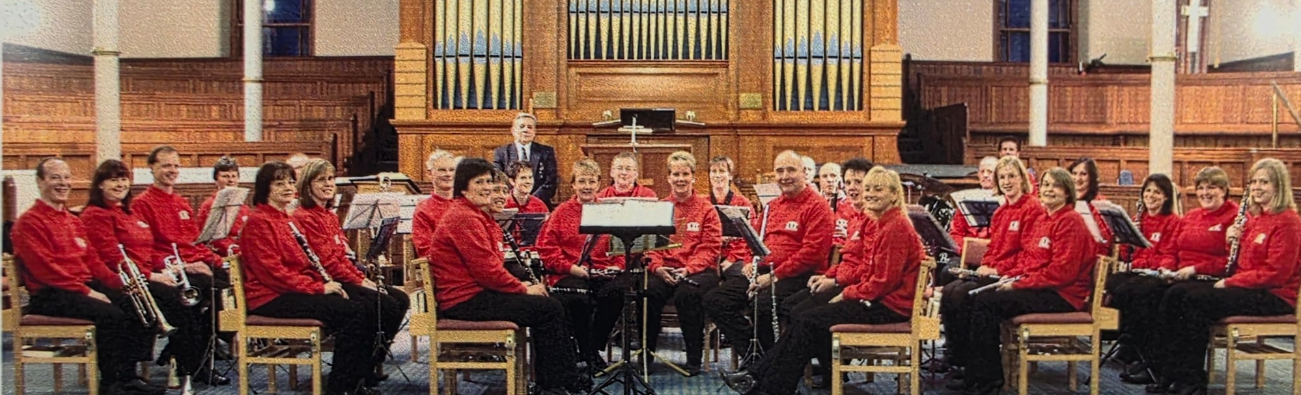
Here we have an early picture of the band from 2004 at our new rehearsal space, when we didn’t take up most of the floor and when we all looked a lot younger!
Photo courtesy of Sue Baxter

Slide 8
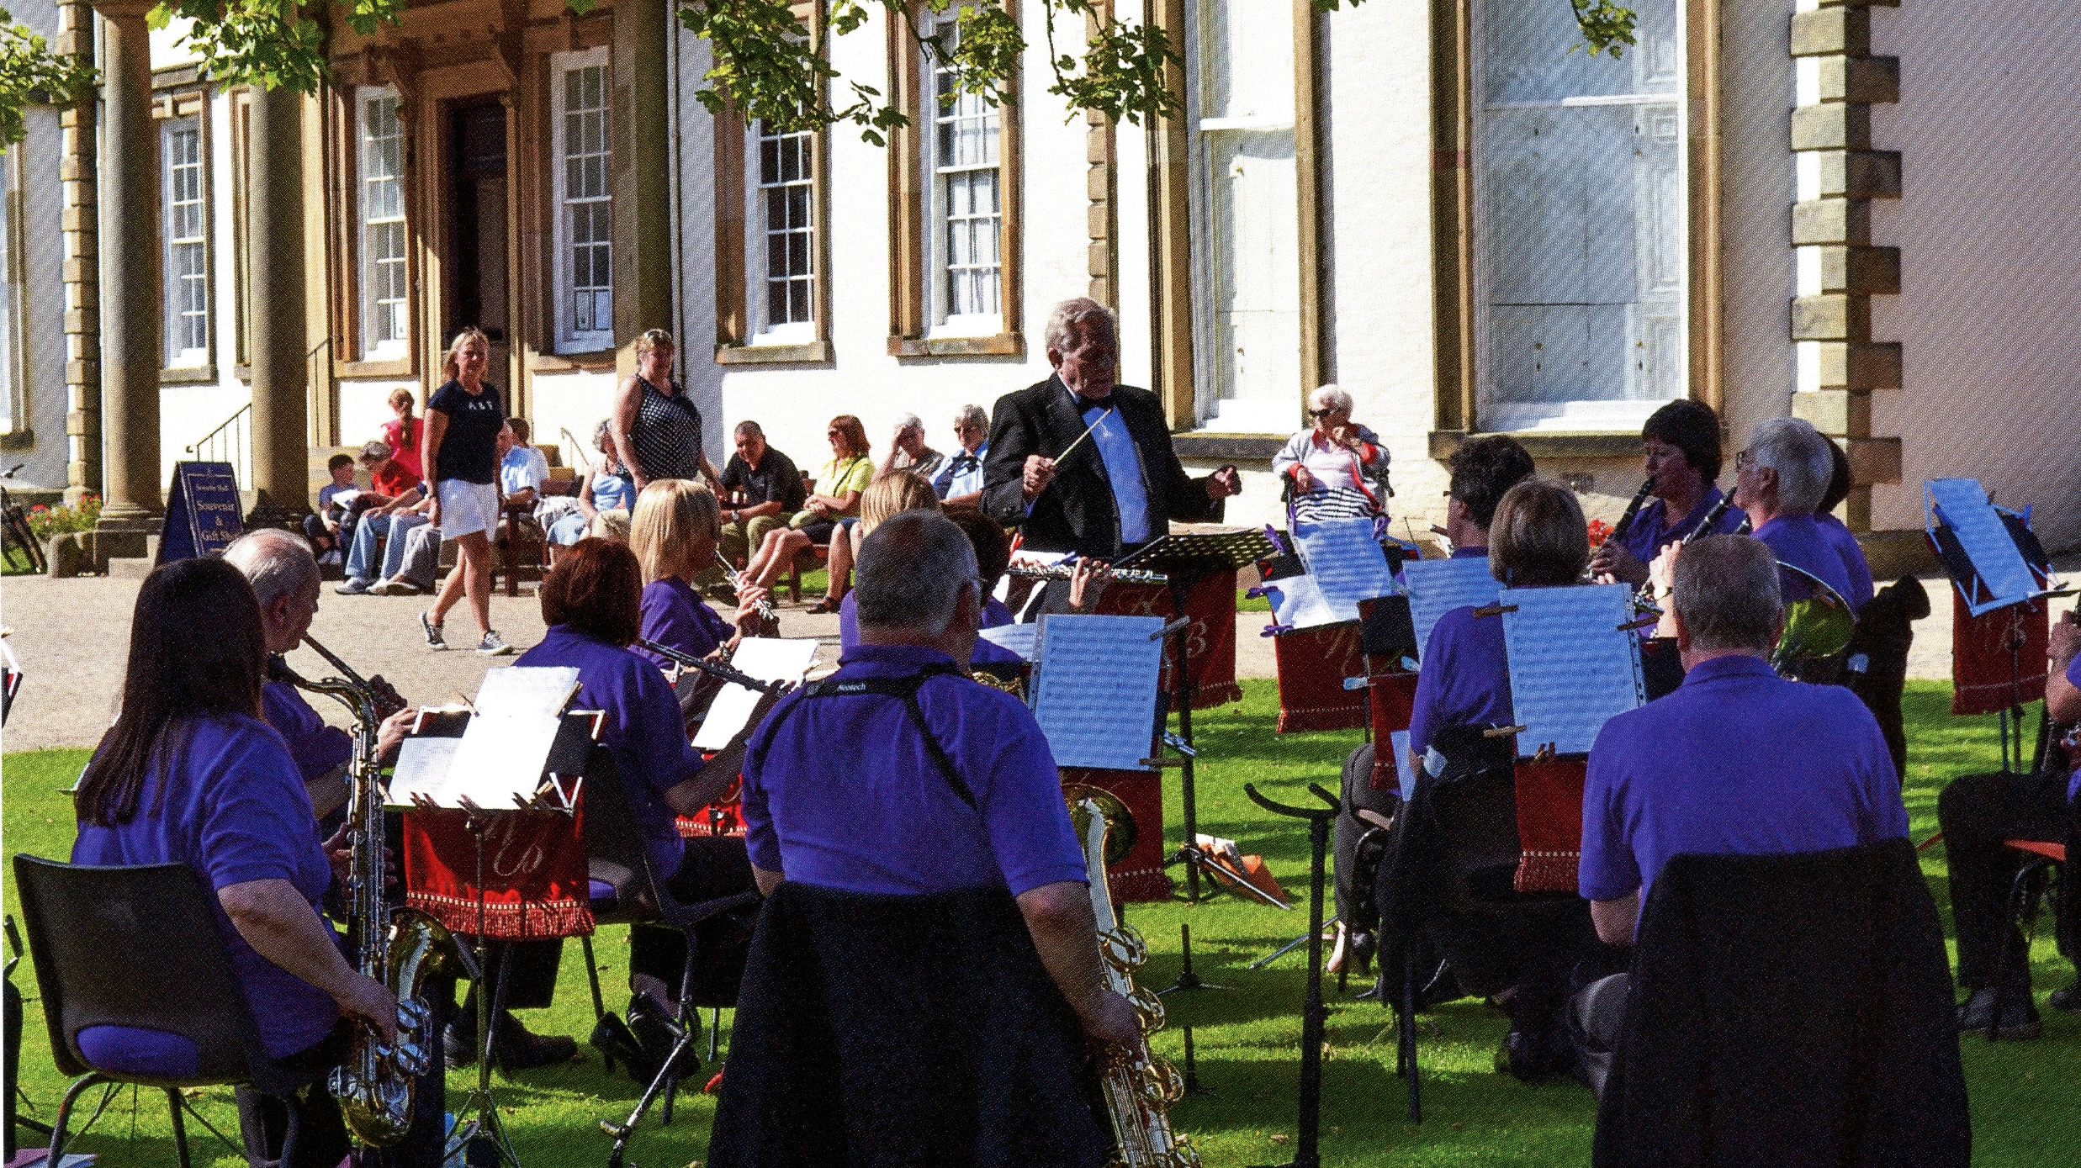
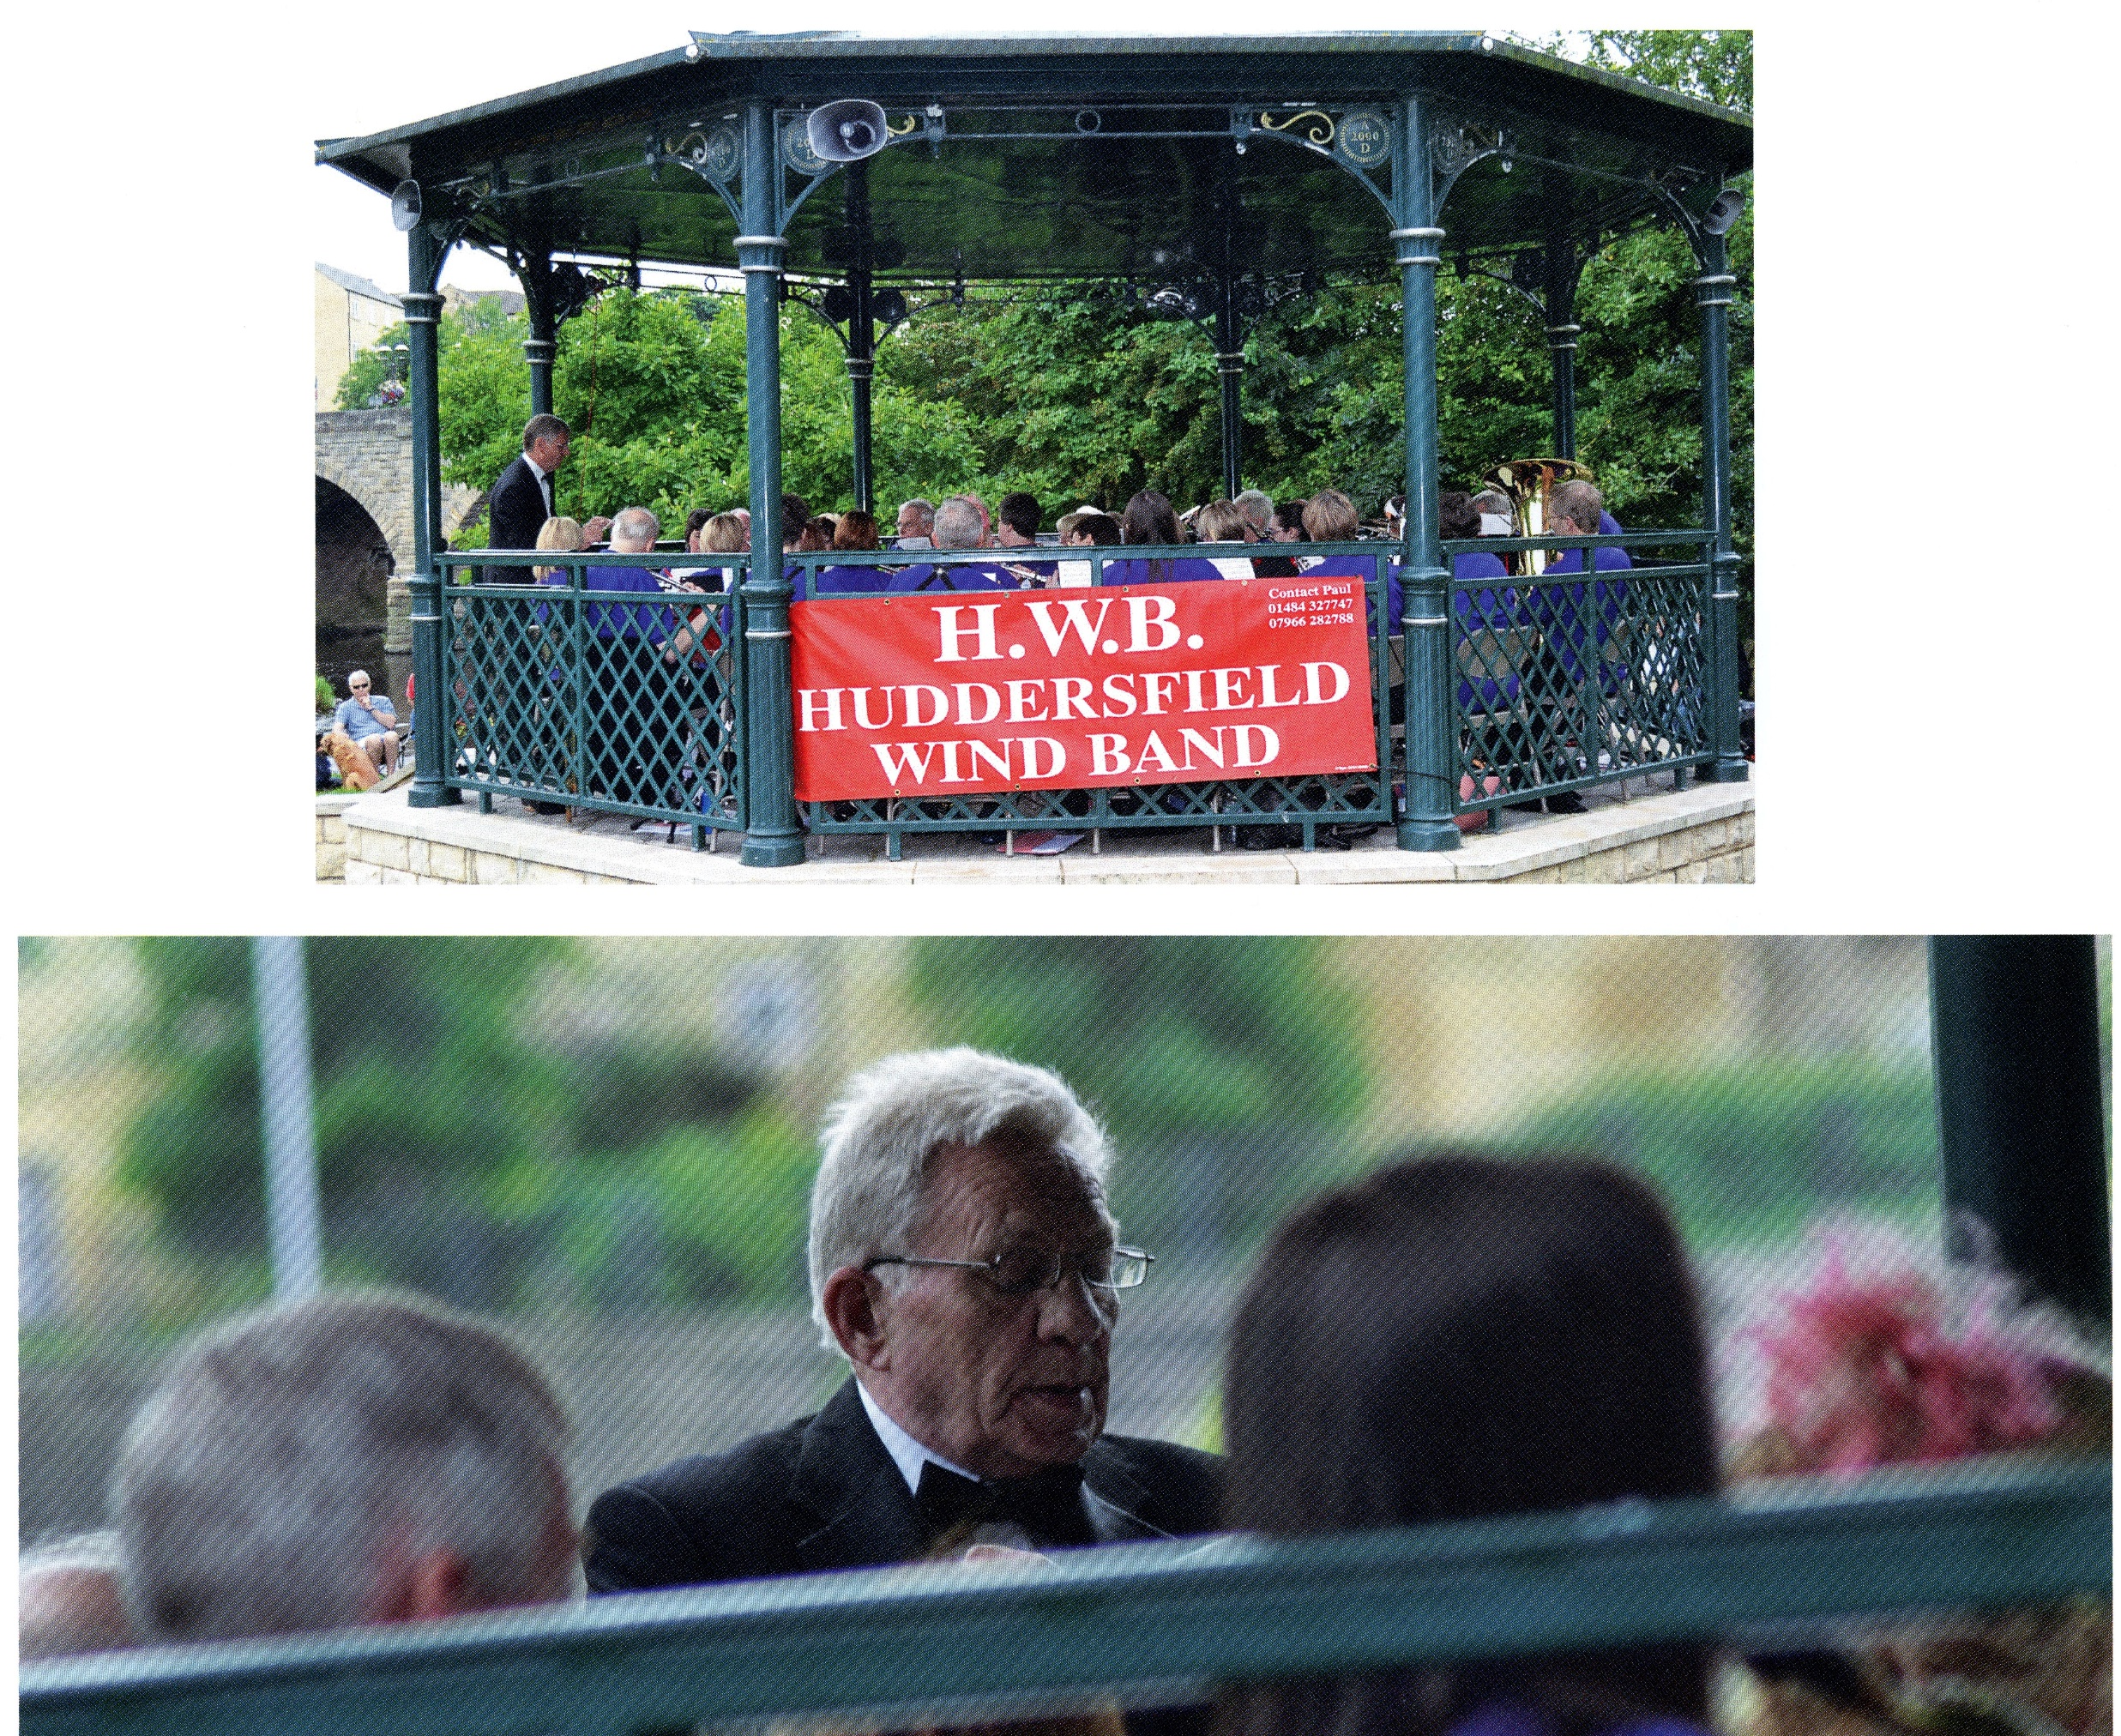
And so began a new era of Huddersfield Wind Band, with the band performing regularly at venues around the county such as Sewerby Hall in Scarborough and the bandstand at Wetherby.

Slide 9
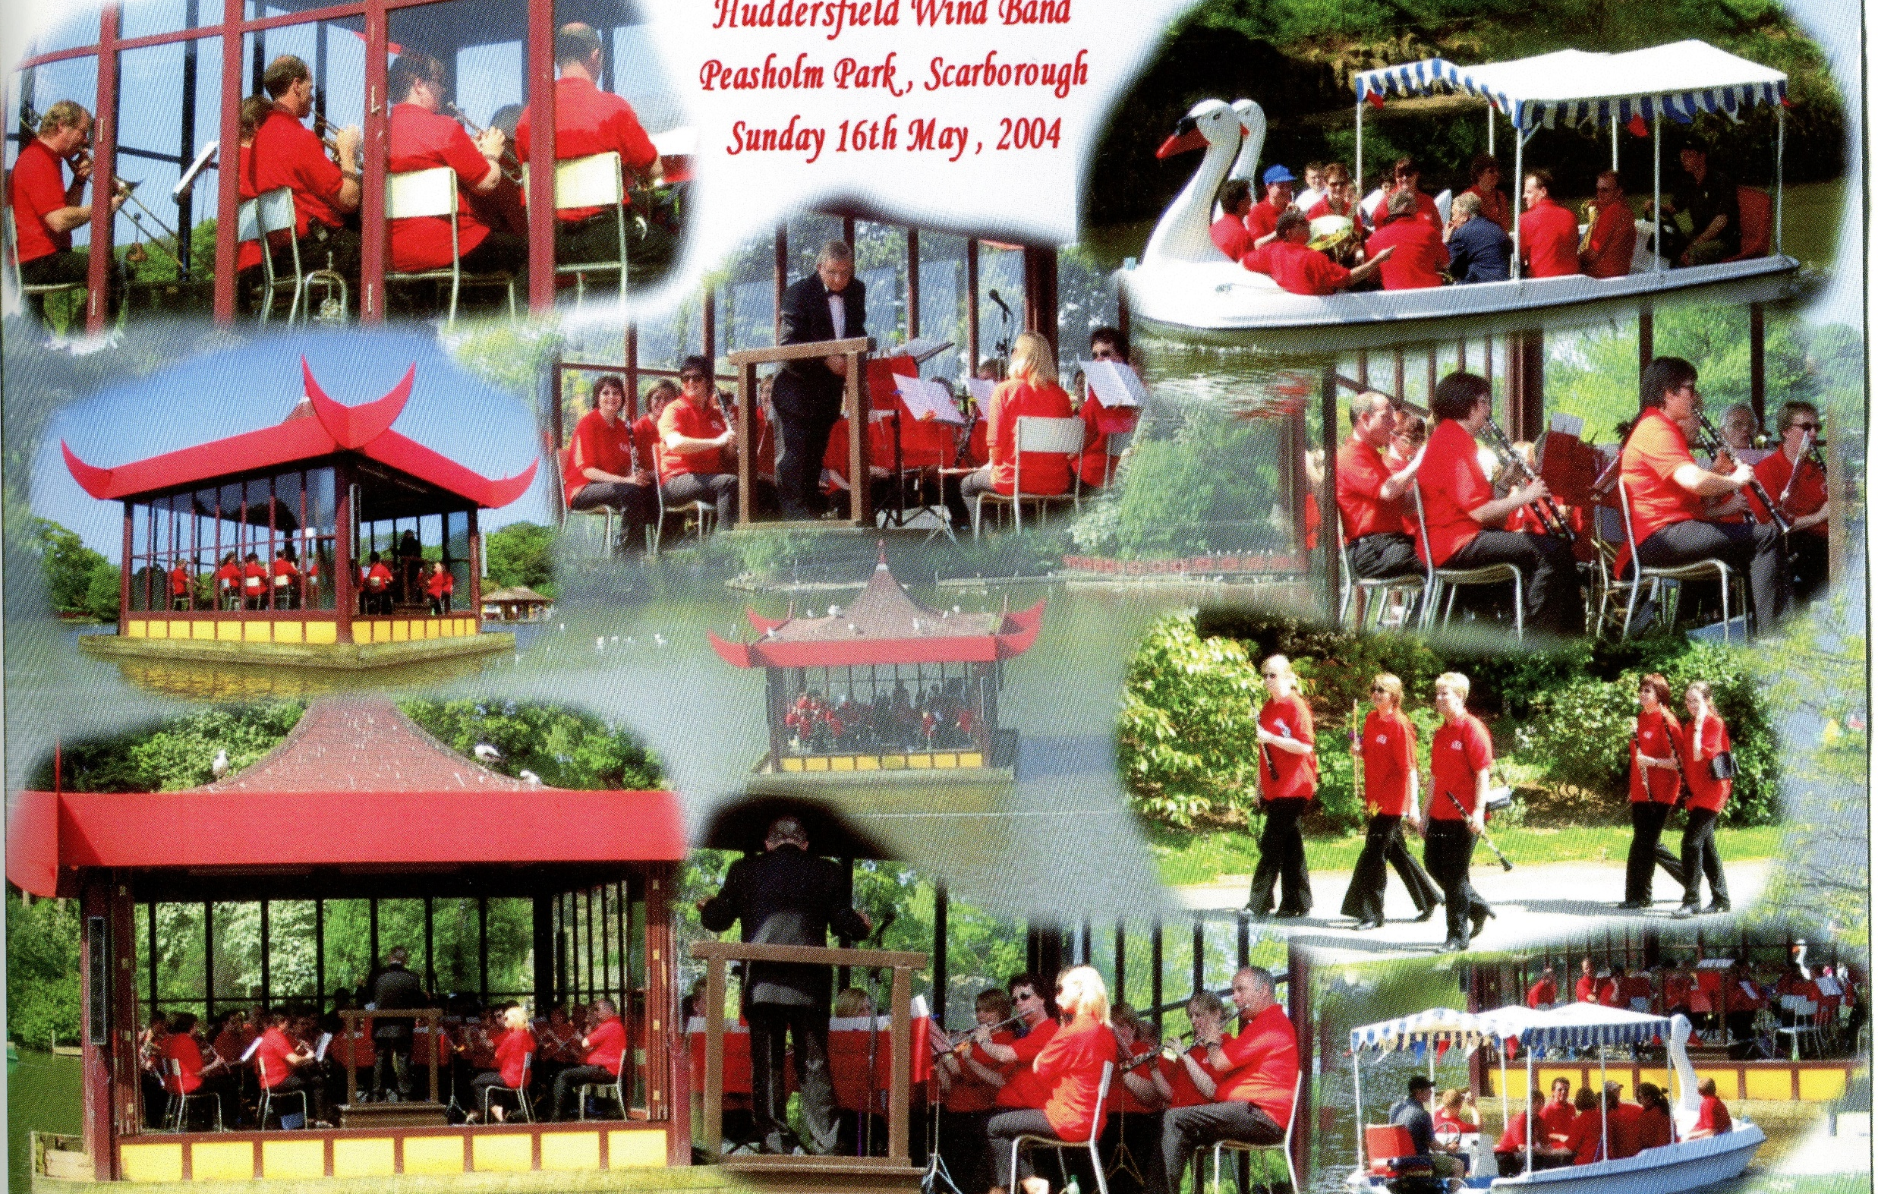
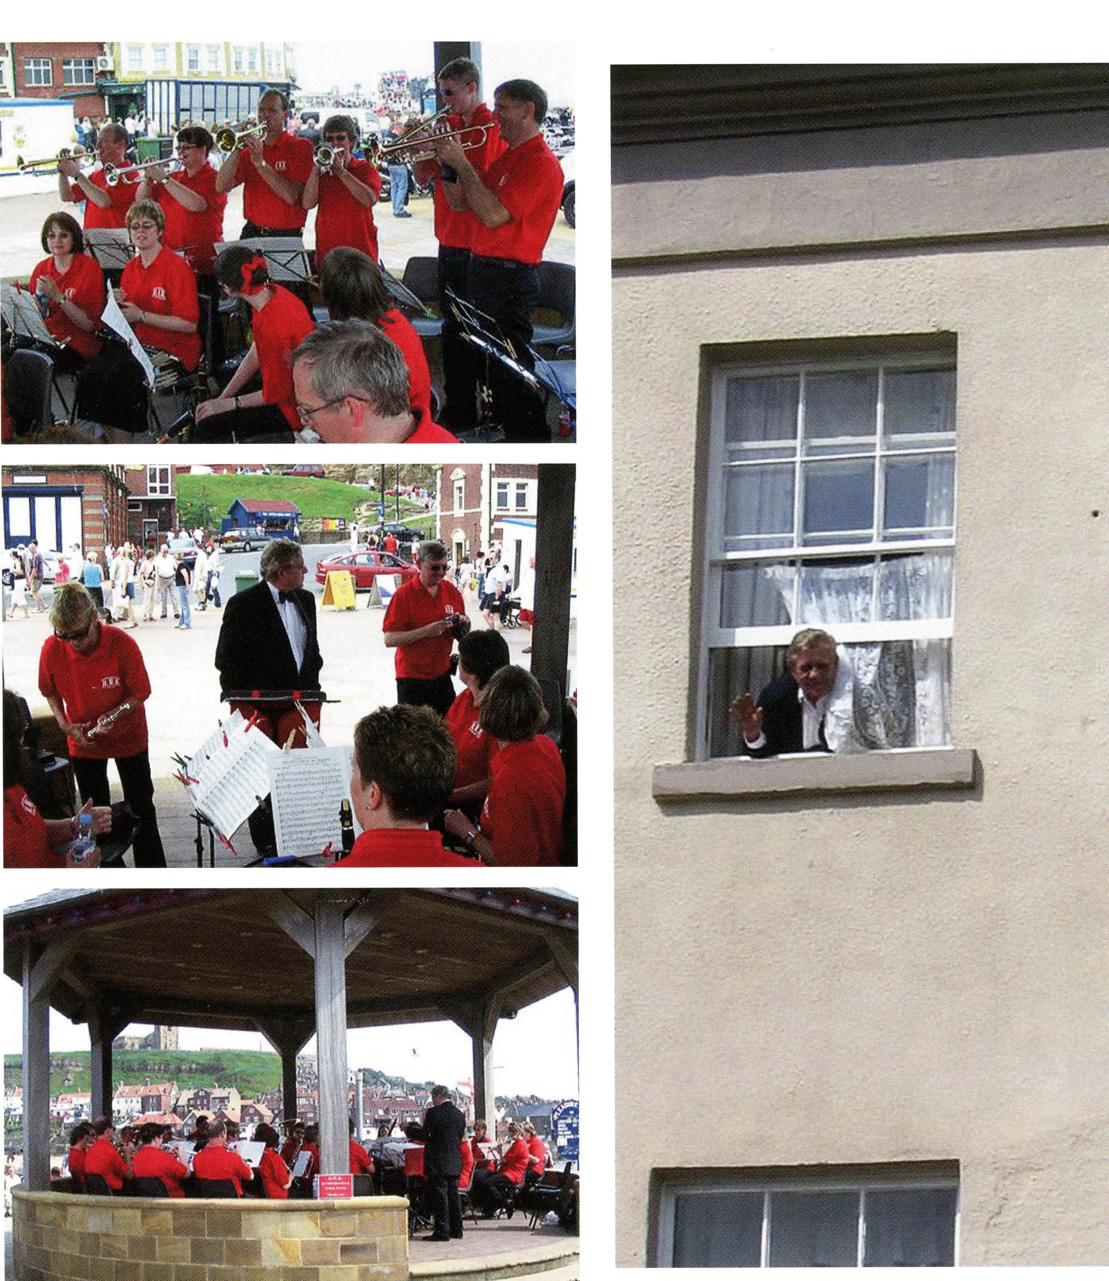
No one will forget the memorable gig at Peasholm Park, which involved a boat ride to get to the bandstand! Also, the concert at Whitby band stand, which was near both the fish dock and the pier.

Slide 10
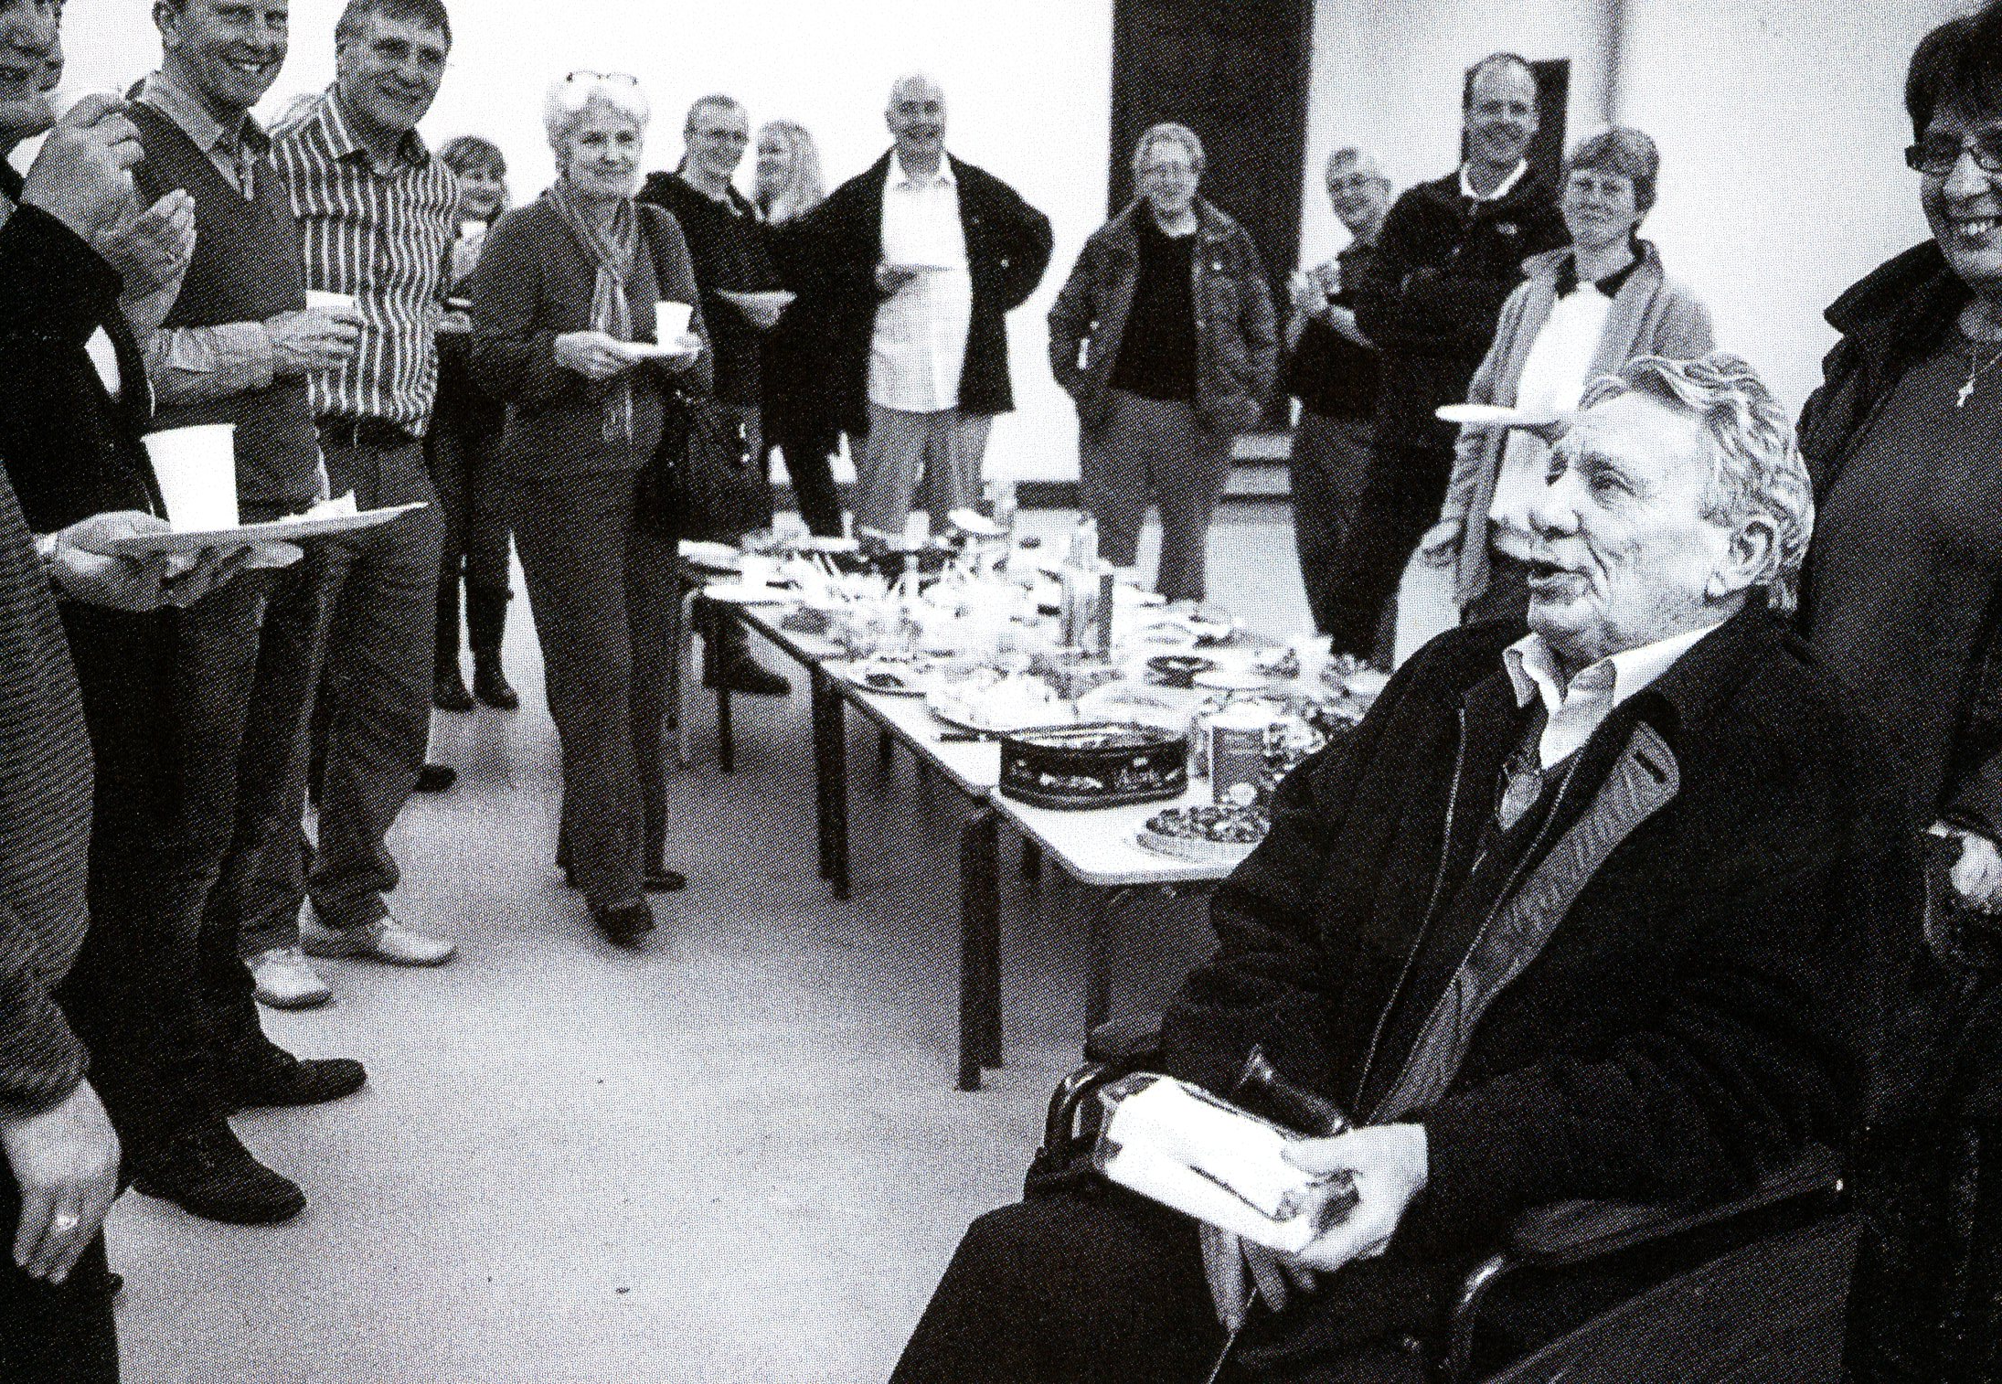
2013 saw the end of an era when Adrian, having suffered a period of ill health, decided that he needed to retire from his role as conductor. There was an emotional farewell party and the band began the search for a new conductor. Sadly, Adrian passed away in 2015.

Slide 11
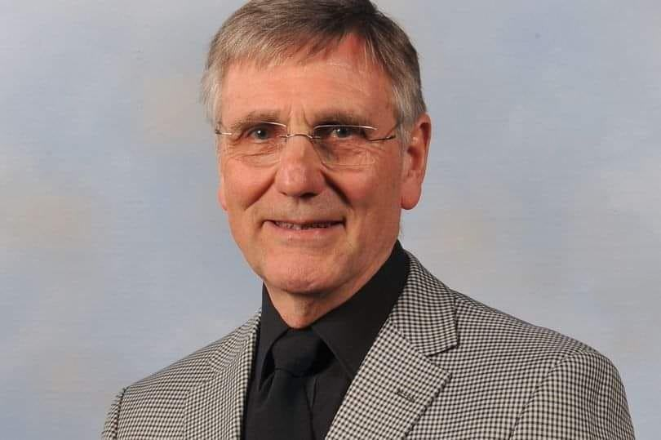
After Adrian’s retirement Neil Jowett, the musical director of Lindley Brass Band and who had joined us primarily to just play trumpet because that is what he loved doing, took over as conductor of the band.
Neil played a pivotal role in HWB’s progress and future success. As an established director and performer Neil developed the bands repertoire and instilled confidence in performers through his extensive brass band discipline.
Through Neil’s experience and determination HWB expanded their repertoire and attracted more members to this community ensemble. Neil’s advice and guidance was invaluable to HWB.
Neil continued as a member of the band after he decided to step down as conductor and enjoyed many great concerts with us.
Sadly Neil passed away in 2021 and was a great loss to the band and to the brass banding world.

Slide 12
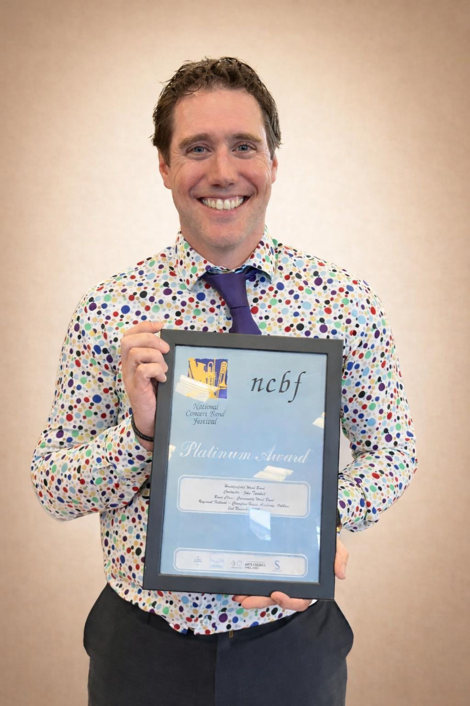
In 2015, the committee offered the musical directorship of HWB to John Turnbull. John came highly recommended from Neil as an experienced musical director and performer.
John further developed the bands repertoire and continued to build on the existing quality of musicianship.
John showed enthusiasm for HWB as well as dedication and humour.
John continues to push the band to be the best version of the themselves.

Slide 13
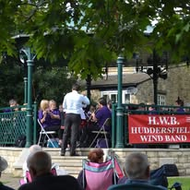
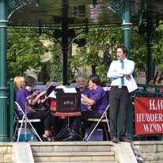
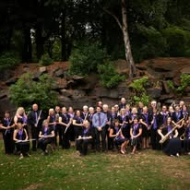
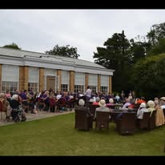
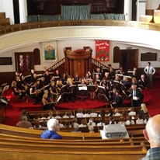
As the band began to grow in numbers we started to do more and more gigs.
Some concerts were at places we had visited before like Wetherby Band Stand, Sewerby Hall. However, we now had new venues such as Batley Methodist Church, Beaumont Park and Normanton Baptist Church.

Slide 14
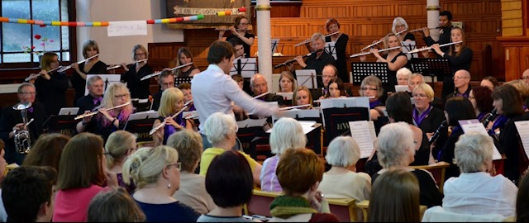
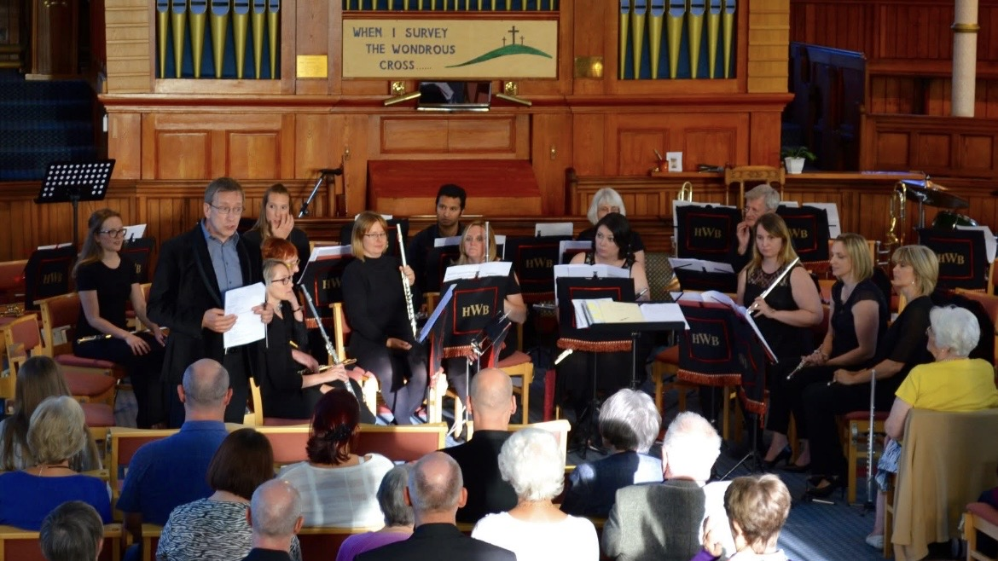
June 2018 saw our first collaboration with the National Flute Orchestra, who were invited to be our guests at the summer concert at Salendine Nook.
A great opportunity to share a concert platform and play alongside such a talented group of players form across the UK.
Everything was going fine and then ……………………..

Slide 15

Everything stopped!
For 16 months!

Slide 16
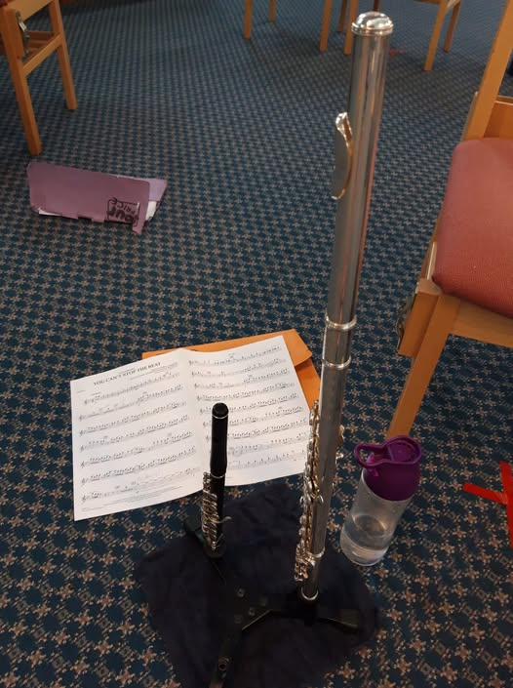
Our first rehearsal post covid, 20th July 2021 was a strange one with
everyone sitting “socially distanced” from each other but glad to be back together.
Our flautist and piccolo player, Jackie, summed up what many of us felt with her post on
Facebook with the comment.
“I’ve enjoyed tonight”

Slide 17
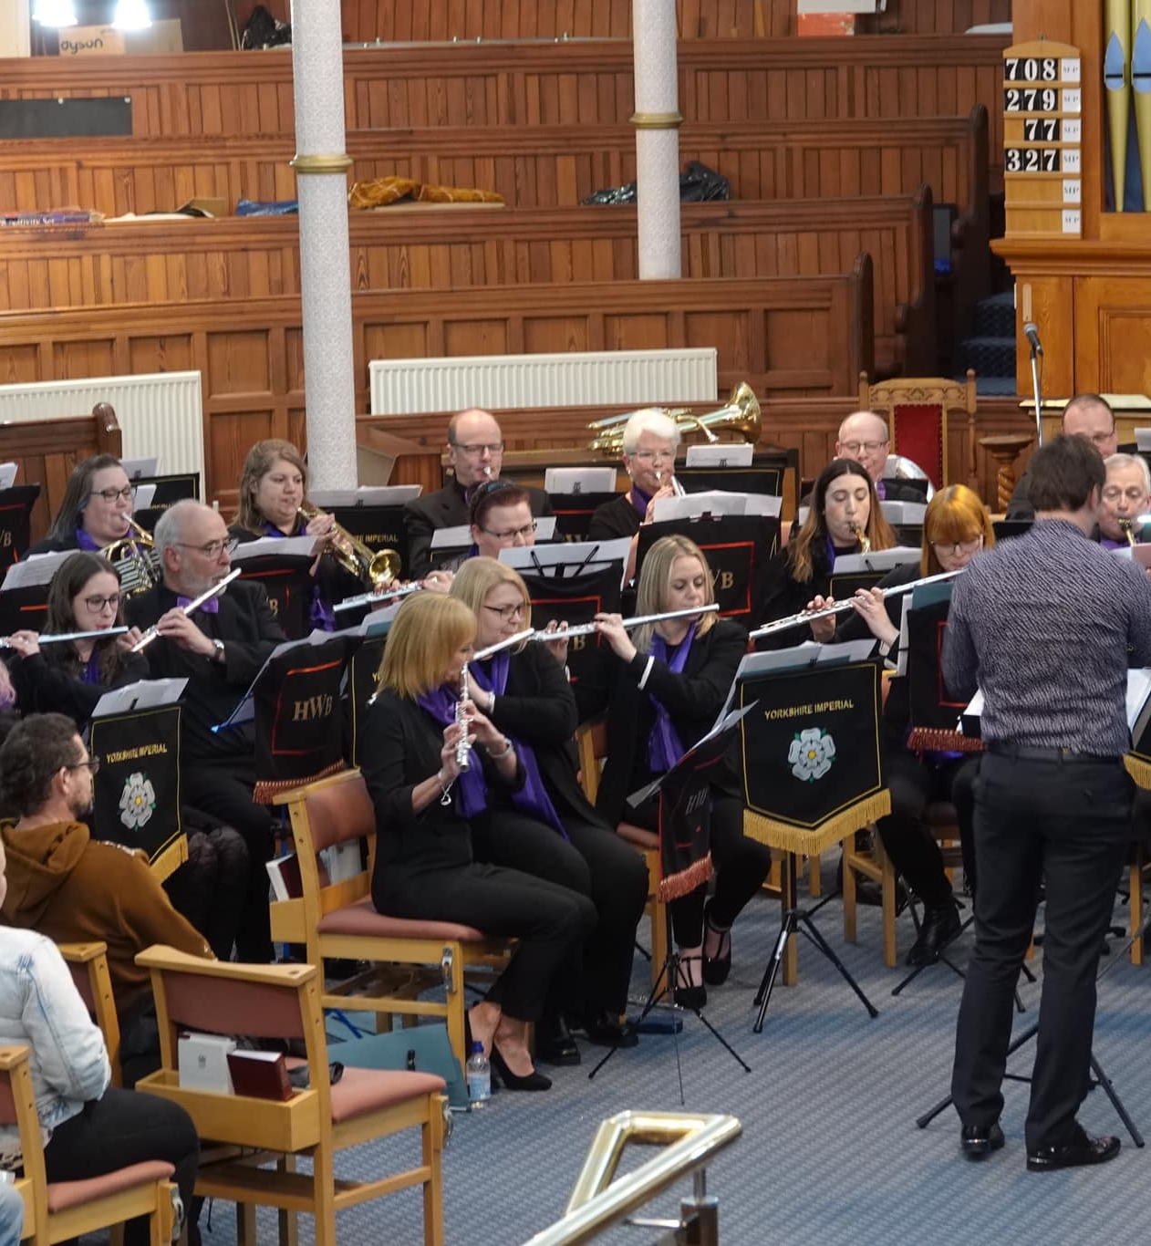
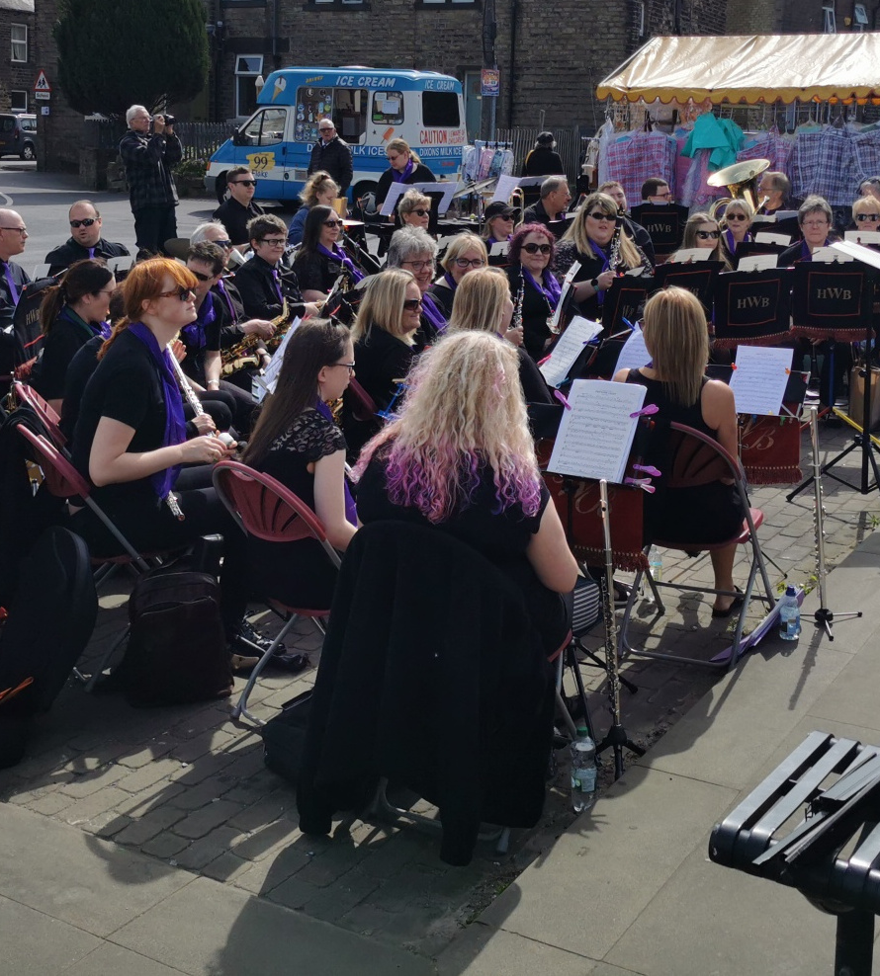
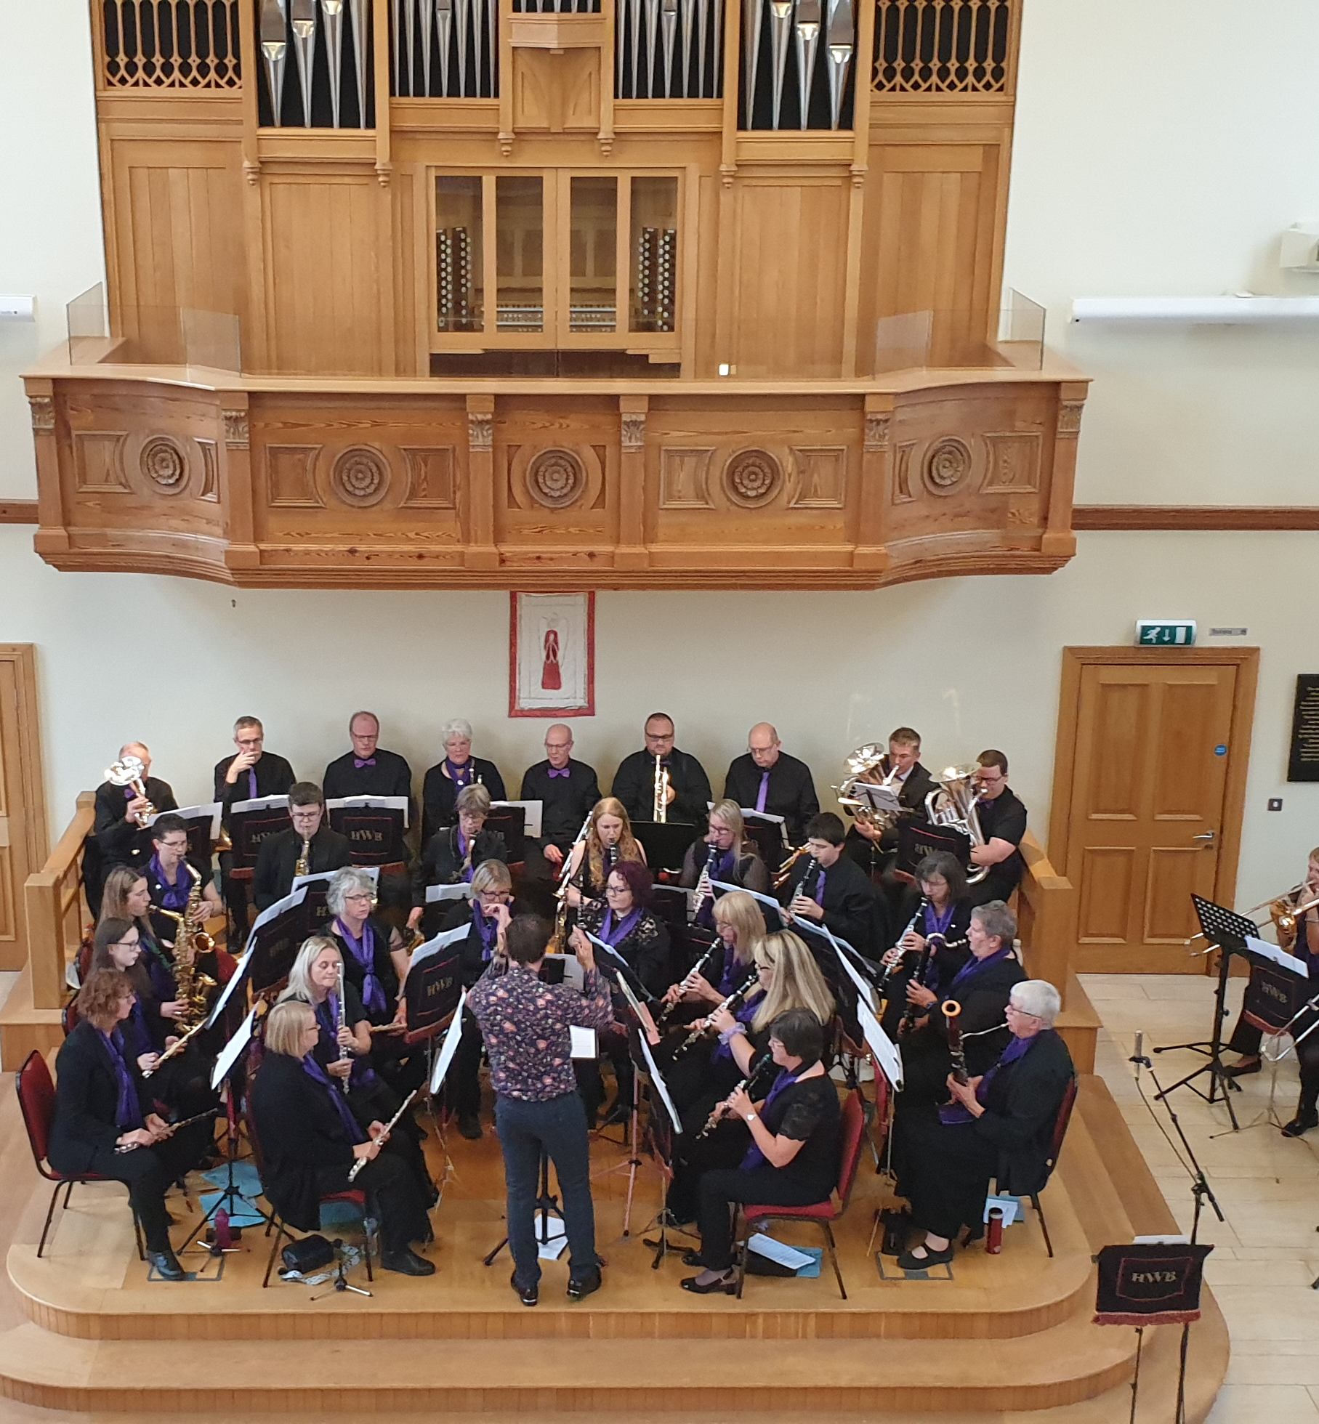
Gradually, as restrictions relaxed, we moved back to our normal rehearsal set up and began practicing for concerts, with some old favourite venues and some new ones.

Slide 18
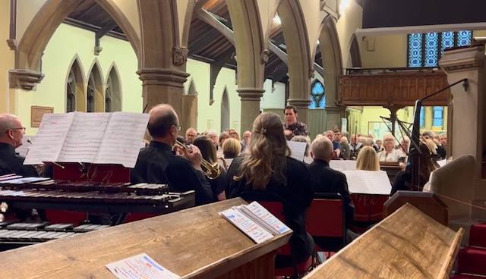
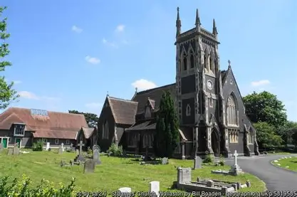
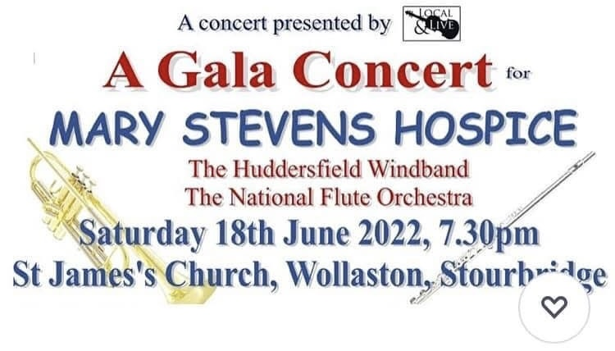
In June 2022, HWB ventured out of Yorkshire to do another joint concert with the National Flute Orchestra in Stourbridge.
This was a charity concert for Mary Stevens Hospice and also turned into a social weekend for the band.

Slide 19
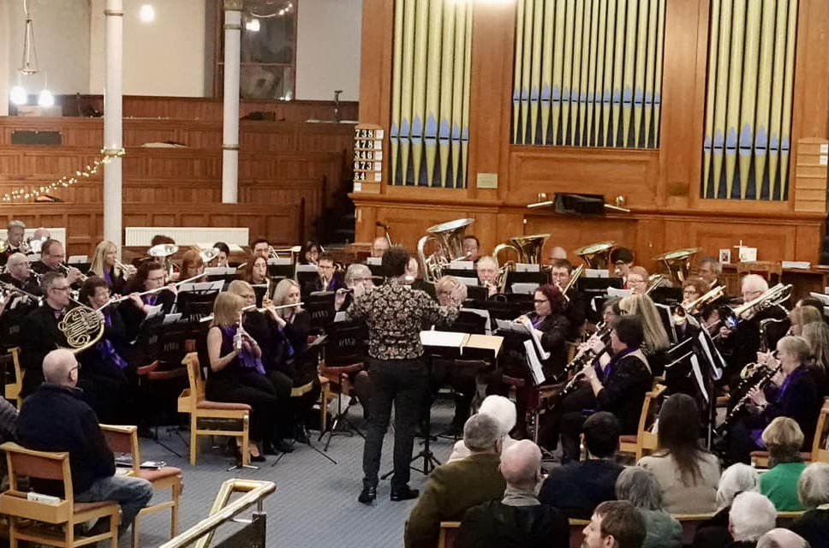
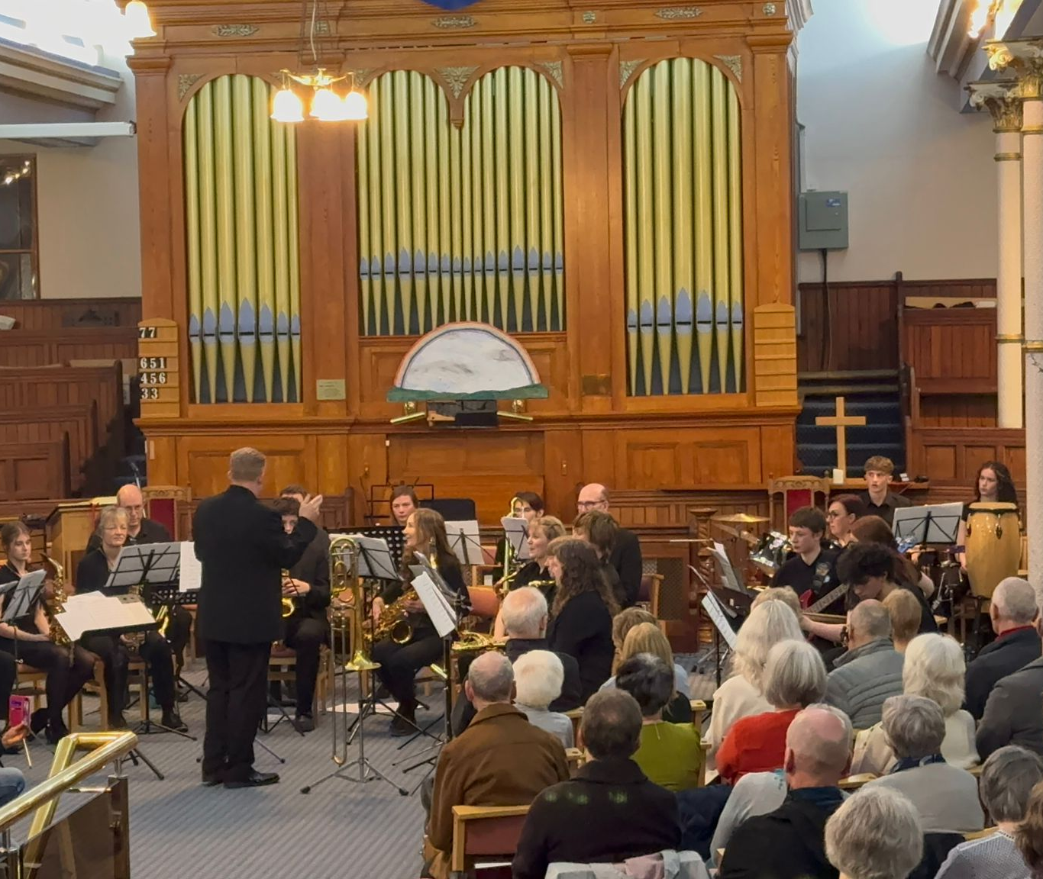
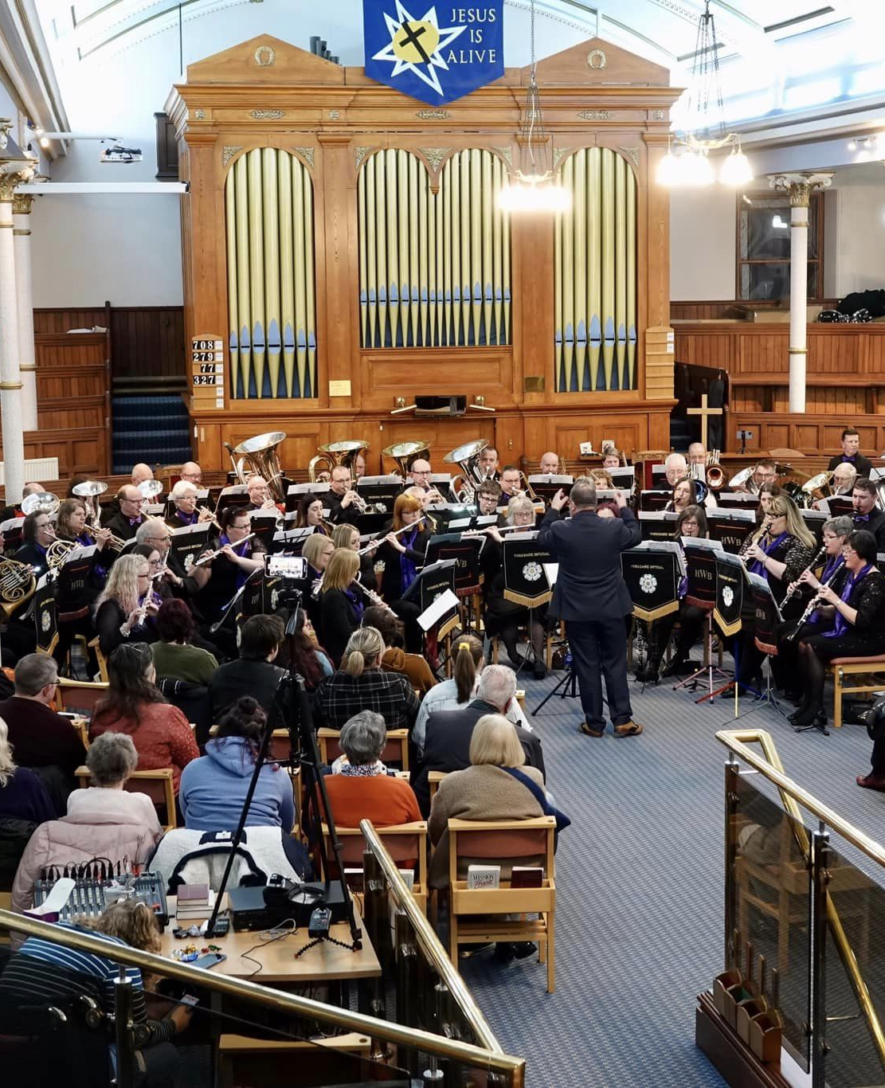
HWB have continued to do many joint concerts. Our guests have included Emley Brass Band, Musica Holme Valley Djembe Drummers, Cliftonville Hand-Bell Ringers, Yorkshire Imps Brass Band, Musica Batley Big Band,
Sometimes space gets a bit tight!!

Slide 20

In early 2023, the band decided to enter the National Concert Band Festival to showcase the band and it’s talented musicians.
In November 2023 we made the short trip across the Pennines to Shaw near Oldham where the regional heats were being held…..

Slide 21
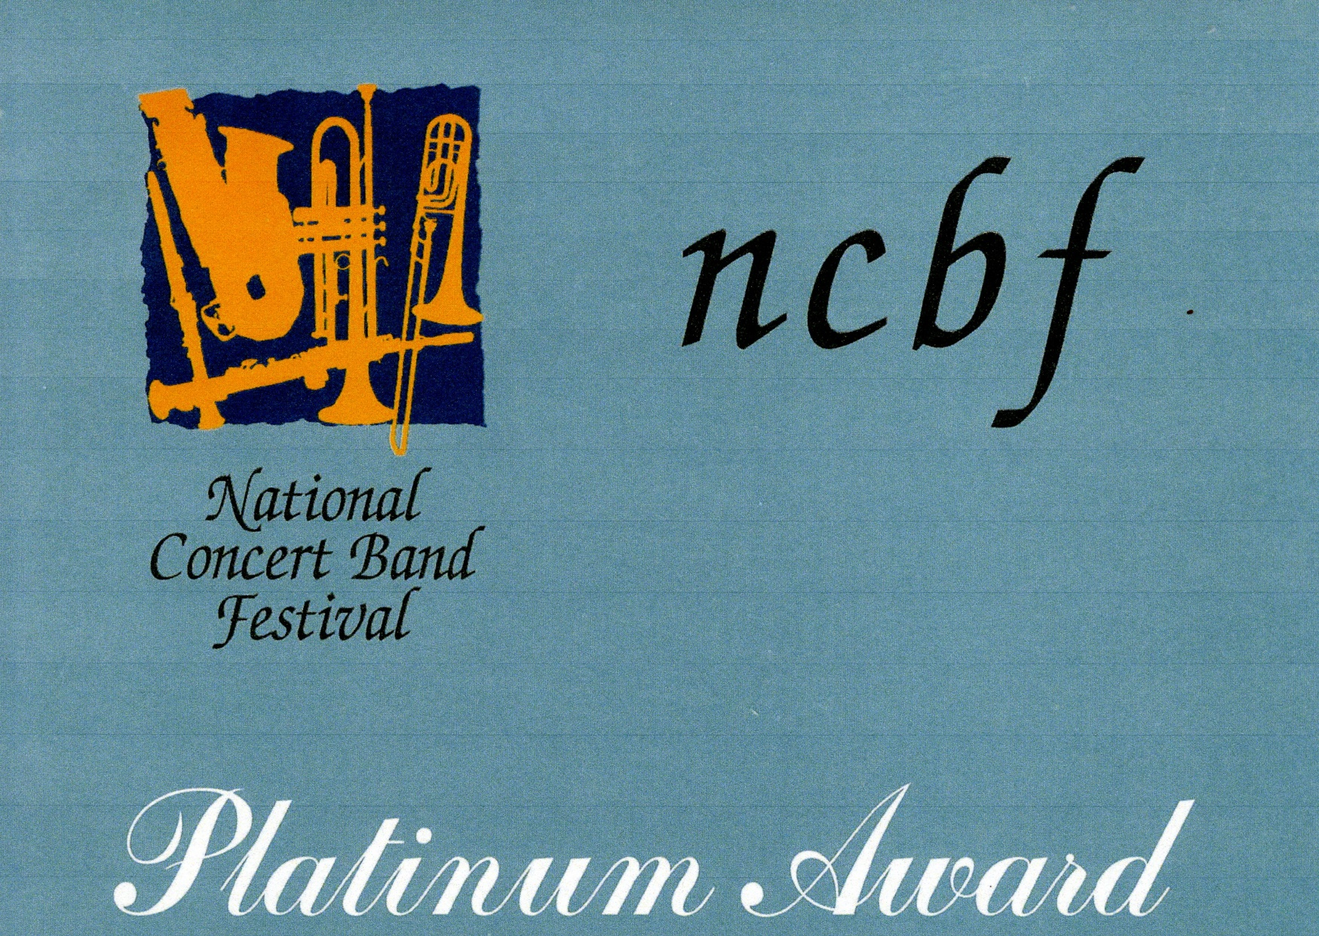
And we came away with a Platinum Award – the highest award in our category of “Community Band” and an invitation to the National Festival in Warwick.

Slide 22
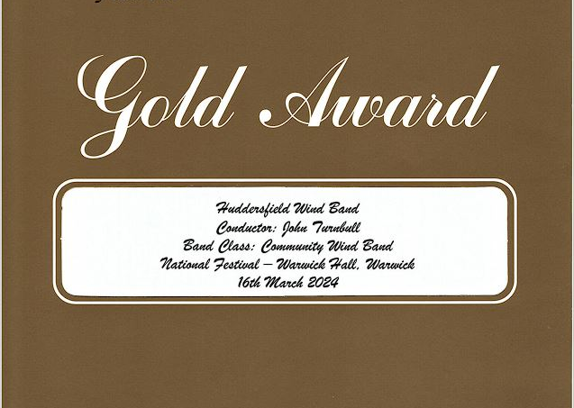
In Warwick, we came away with an impressive Gold Award in our section. We had the opportunity to perform alongside the best bands in the country, including university music departments and other leading institutions.
This was a great experience for the band, not only to showcase the high standard of the band, but also to gain invaluable feedback from the adjudicators to help improve and get to the next level.

Slide 23
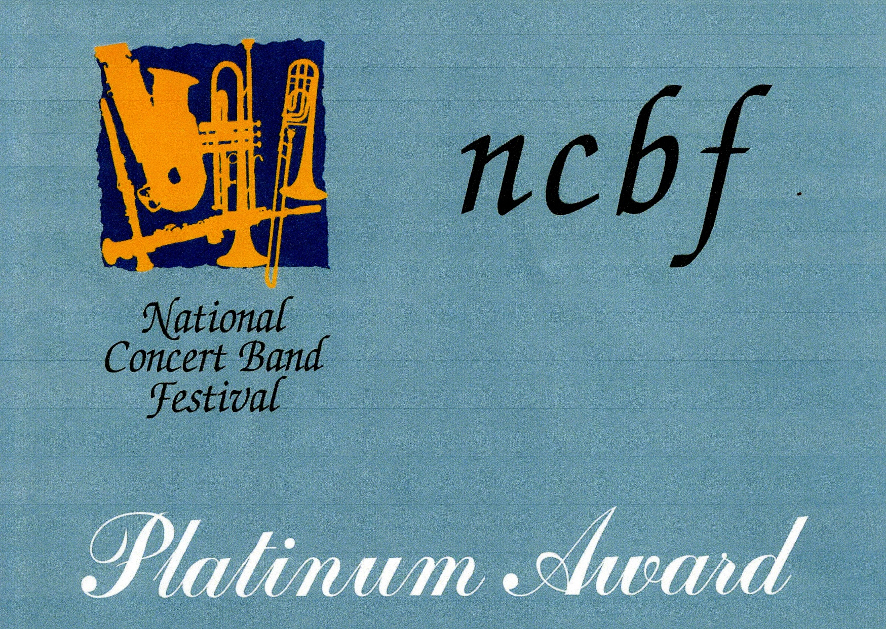
Encouraged by the success in November 2024, we took part in the regional heats in Oldham and once again gained a prestigious platinum award and an invitation to the National Festival for 2025, which was to be held at the Royal Northern College of Music in Manchester.

Slide 24
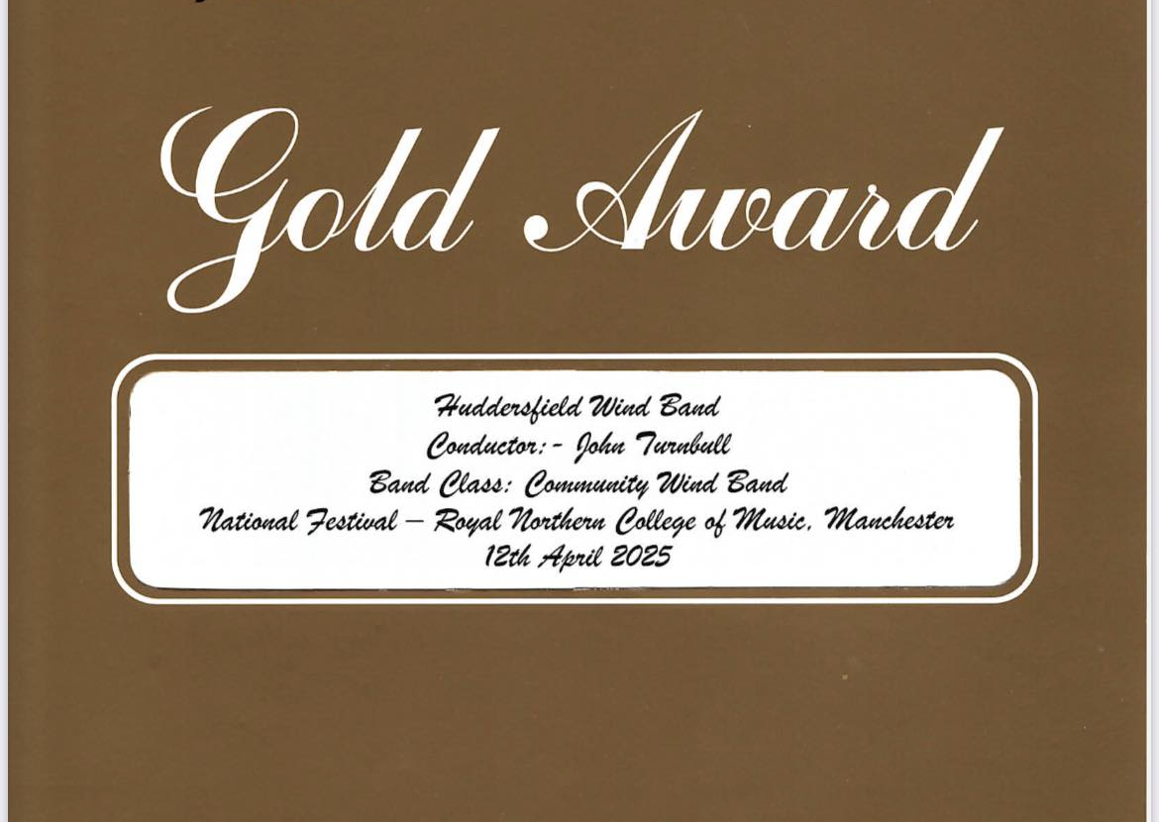
Our trip to Manchester was rewarded with another fantastic Gold award.
With further encouragement and positive comments from the adjudicators, we committed to performing at the regional heats in November 2025….

Slide 25
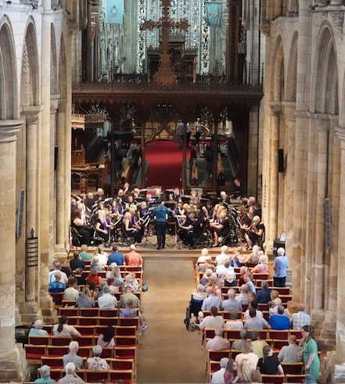
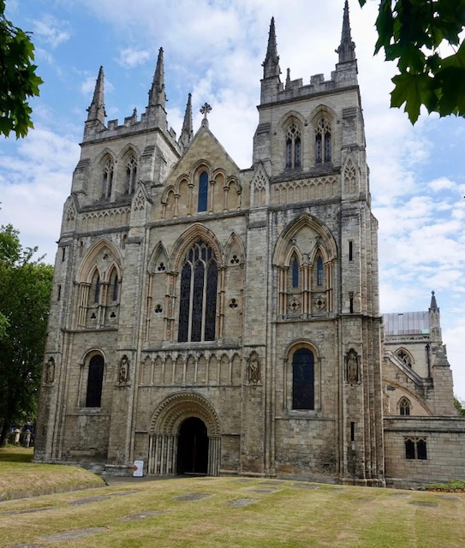
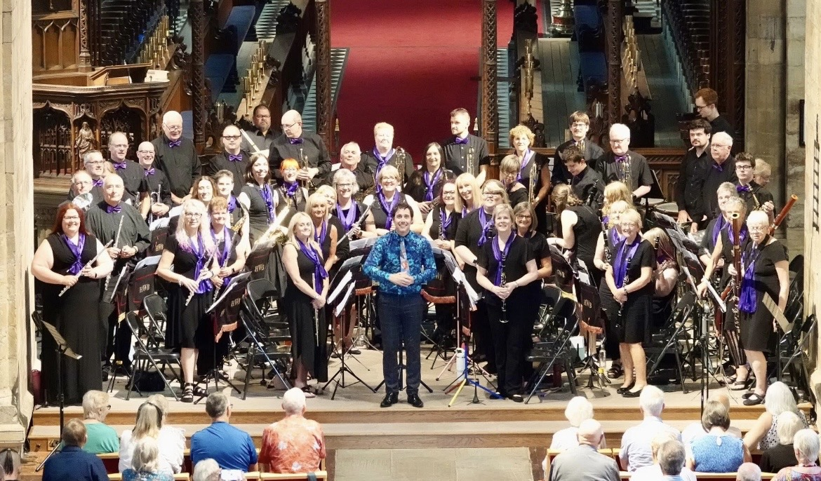
July 2025 provided another new and exciting venue for HWB.
This time the fabulously impressive Selby Abbey.
The Abbey hosts many concerts for world famous artists and bands, so we truly were in great company performing at this magnificent venue.

Slide 26
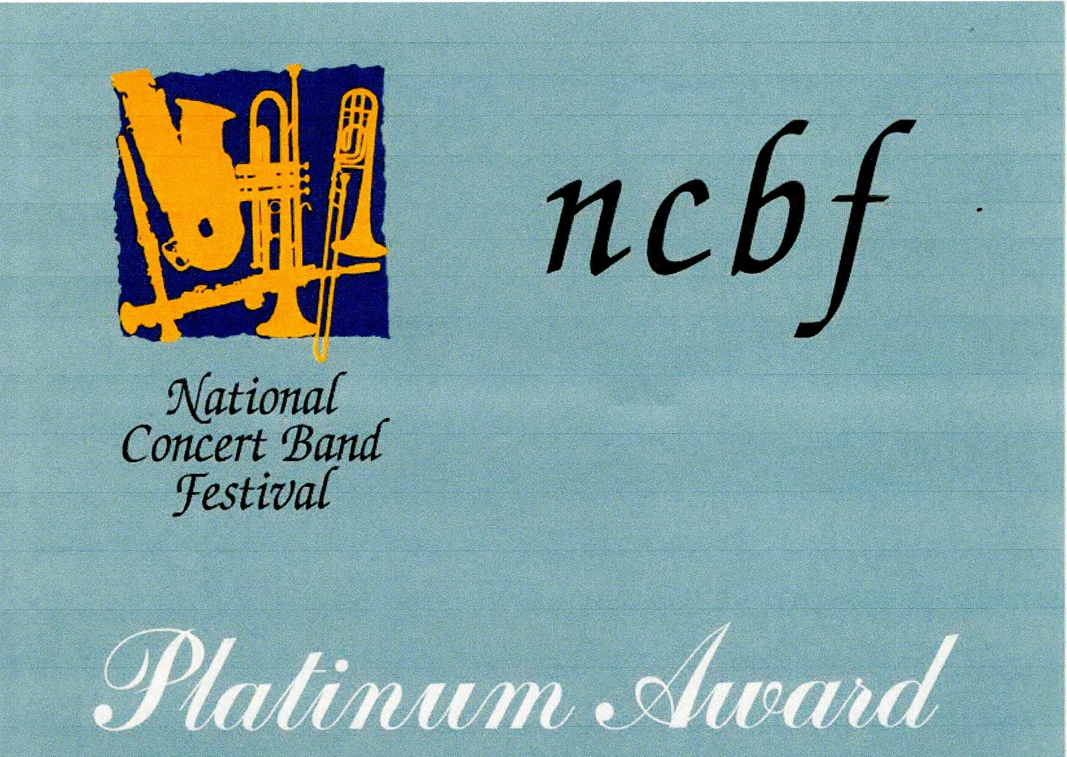
Despite the early start (we were first on that day), the band were delighted to come away with another platinum award. This was our third regional success in three years, and an invitation to the Naional Festival at the Royal Northern College of Music in Manchester.

Slide 27
At this years National Festival, after another early start on Saturday 11th April, the band played at the Royal Northern College of Music in Manchester. The band performed a top quality, colourful and contrasting programme, which led us to achieve the tremendous Platinum award at the National Level. Subsequently, this has cemented our place as one of the premier concert bands in the country.

Slide 28
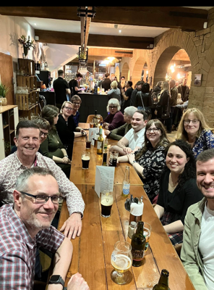
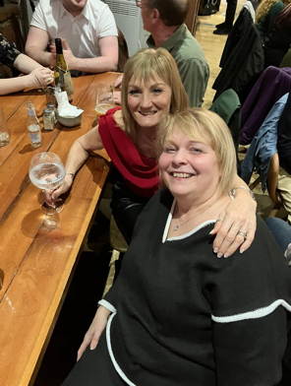
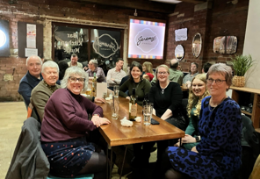
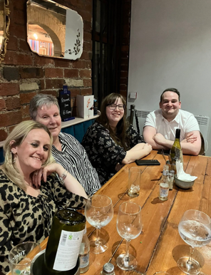
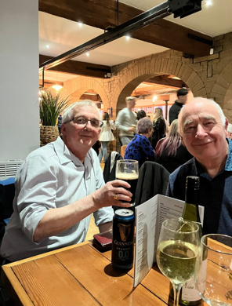
It’s also important to have a social aspect too !!

Slide 29
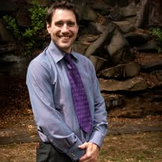
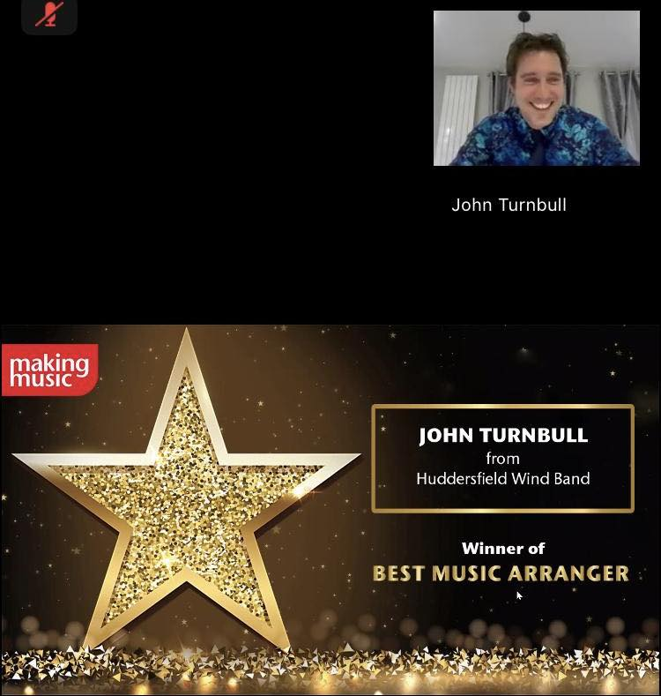
But it’s not only the band that wins awards.
Many of the pieces we play are arranged by our MD John. Unbeknownst to John, he was put forward for the Best Music Arranger at the Making Music Awards
And he only went and won!

Slide 30
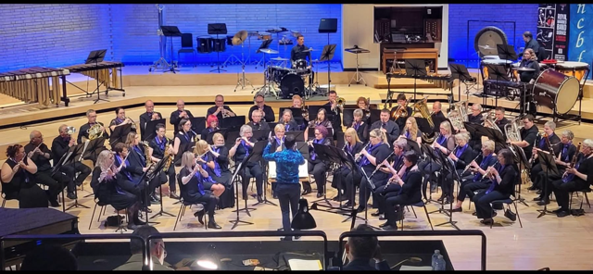
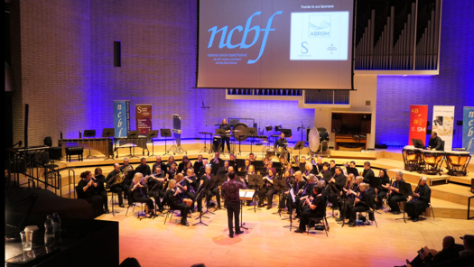
The future looks bright and exciting for HWB.
Here’s to the next 40 years !!

